Slide 1
Trend Analysis for Monitoring Progress Toward Objectives and for Program Evaluation
Friday, June 1, 2012 8:30-10:00
Deborah Rosenberg, PhD
Research Associate Professor
Division of Epidemiology and Biostatistics
University of IL School of Public Health
Training Course in MCH Epidemiology

Slide 2
Analyzing Trends
Some special considerations when
summarizing data by “time”:
Independence
Smoothing
Timeframe
Confidence Intervals v. Confidence Bands

Slide 3
Analyzing Trends
Historically, trend analysis has focused on data from large populations over long periods of time. For example, international comparisons between the 50 or 100 year trend in infant mortality have been (and still are) of interest.
Increasingly, however, analysis of trends in smaller populations and/or smaller geographic areas is considered necessary for improved public health decision making.

Slide 4
Analyzing Trends
Different purposes for looking at data over time
Examining the general pattern of change over time:
Looking for patterns of increase or decrease in health status, services, or systems indicators
Comparing one time period to another time period
Assessing the impact of a program, or the introduction of a new medical procedure

Slide 5
Analyzing Trends
Comparing one geographic area to another:
The relative standing of areas may vary by year—trend data provide a “fairer” area to area comparison
Comparing one population to another:
The relative standing of populations may vary by year—trend data permits an assessment of the nature of disparities
Making projections:
Monitoring progress toward a national or local objective, or planning levels of services

Slide 6
Analyzing Trends
Analytic Issues
When trend data is based on small numbers, the stability of the rates must be taken into account.
When the time period to be analyzed is relatively short, the ability for making future projections is compromised.
The shorter the time period, the less information is available and the less likely it is to correctly identify patterns of change

Slide 7
Analyzing Trends
Analytic Issues
The observed trend might be confounded by changes during the time period:
      programs or policies
      medical interventions
      reporting definitions
      demographic composition
      reporting accuracy
      social / cultural practices

Slide 8
Analyzing Trends
Smoothing Techniques
Using the natural log transformation
If rates are decreasing over time, the log transformation will slow the approach to zero making any projection of future rates more reasonable.
Combining years of data—weighted averages
Gain stability in the rates, but lose information
Moving averages
Gain stability in the rates, and preserve information

Slide 9
Analyzing Trends
Regression analysis—Gain stability, preserve information, but lose the "real" data
If data are correlated, regression approaches that account for this can be used—time series analysis—identify the correlation structure

Slide 10
Analyzing Trends
Regression analysis permits a statistical test for linear trend as well as an assessment of the approach toward an objective or target
In addition, the annual percent change can be calculated from this model as:

Slide 11
Analyzing Trends
Regression analysis permits calculation of a confidence band as opposed to separate confidence intervals around each annual rate
This is preferable because it assesses the reliability of the trend line itself rather than the reliability of each observed point that makes up the trend
Confidence bands also correctly highlight that the farther away from the center of the time period, the less reliable the predicted data become
http://www.uic.edu/sph/dataskills/skillbytes/trends/

Slide 12
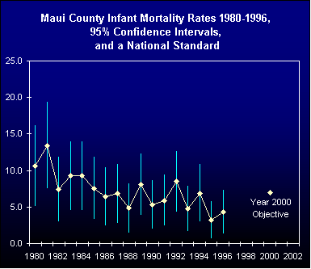
Analyzing Trends
Example
Approaches

Slide 13
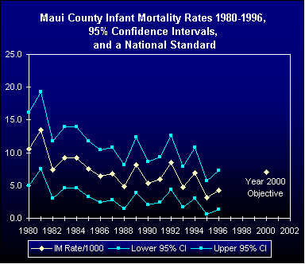
Analyzing Trends
Example
Approaches

Slide 14
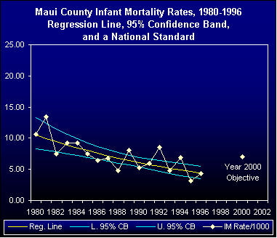
Analyzing Trends
Example
Approaches

Slide 15
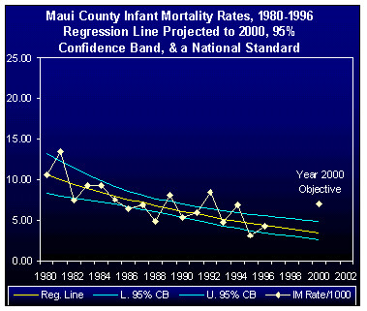
Analyzing Trends
Example
Approaches

Slide 16
Analyzing Trends
Even though using smoothing techniques / regression approaches is important for quantifying trends, presenting the observed data is also critical for most audiences

Slide 17
Using Trend Data to Set Targets and Monitor Progress Toward Objectives
Trend data can be used to set targets
on the path to achieving an objective:
Targets might be set
based on continuing
the recent past trend,
or the slope could be
“forced” to accelerate
the time at which an
objective will be met

Slide 18
Using Trend Data to Set Targets and Monitor Progress Toward Objectives

Slide 19
Using Trend Data to Set Targets and Monitor Progress Toward Objectives
Will data for different population groups
be integrated?
Targets may depend on whether
disparities exist across groups.
        •Crude (unstratified)?
        •Stratified by medical risk status?
        •Stratified by geography?
        •Stratified by race/ethnicity?
        •Stratified by income?
        •Stratified by income and geography?
        • Etc., etc., etc.?

Slide 20
Using Trend Data to Set Targets and Monitor Progress Toward Objectives
Different patterns over time for different strata
for a Single indicator

Slide 21
Using Trend Data to Set Targets and Monitor Progress Toward Objectives
Example Logic Statements
  If current values vary across groups
    then targets will be set as…
  If trends over time vary across groups
    then targets will be set as…

Slide 22
Using Trend Data to Set Targets and Monitor Progress Toward Objectives
    If stratification is used, how will data availability and small numbers be addressed?
        Collapsing strata?
        Indirect standardization?
        Synthetic estimation?

Slide 23
Using Trend Data to Set Targets and Monitor Progress Toward Objectives
Using trend data, predict the time at which each of several indicators is likely to meet or surpass a relevant objective, and then compare across indicators
Example: Indicator #1 -- 2019
Indicator #2 -- 2012
Indicator #3 -- 2013
For this example, priority might be given to improving indicator #1 (assuming other factors have been taken into account)

Slide 24
Using Trend Data to Set Targets and Monitor Progress Toward Objectives
When setting targets for more than one indicator, the relative performance across indicators may influence the target setting process.
For example, you may want to set more challenging targets for indicators farther from a long term goal as an added incentive to make that issue a programmatic priority.

Slide 25
Using Trend Data to Set Targets and Monitor Progress Toward Objectives
Different patterns over time and
different distance from objectives
2 Indicators

Slide 26
Using Trend Data to Set Targets and Monitor Progress Toward Objectives
Conduct statistical tests of the difference between the current level of indicators and relevant objectives, and then compare the magnitude of the differences according to the test results:
The statistical testing could be carried out “crudely”, stratified by population groups or areas, or using “adjusted” indicators if appropriate.

Slide 27
Using Trend Data to Set Targets and Monitor Progress Toward Objectives
Conduct statistical tests, but this time test the difference between the projected level of indicators and relevant objectives, and then compare the magnitude of the differences according to the test results:
Again, the statistical testing could be carried out “crudely”, stratified by population groups or areas, or using “adjusted” projections if appropriate.

Slide 28
Using Trend Data to Set Targets and Monitor Progress Toward Objectives
The results of using the current level of the indicator and the projected level of the indicator may yield different, but equally important information.
One indicator may currently be farther from its objective than another indicator, but it may also be exhibiting a faster rate of improvement over time and therefore be projected to be closer to its objective than the other indicator in the future

Slide 29
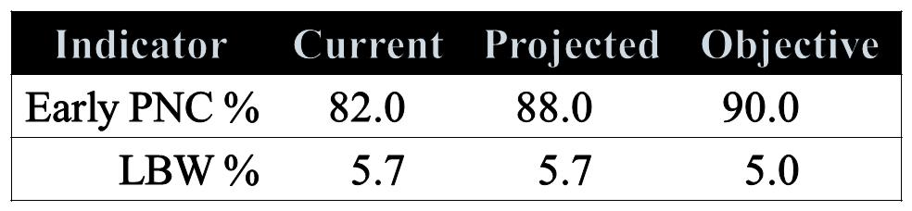
Using Trend Data to Set Targets and Monitor Progress Toward Objectives
Example of potentially differing statistical result for with current and projected indicators, stratified by area:
Considering current values, early PNC % appears to be farther away from its objective; considering projected values, LBW % is farther away from its objective—early PNC % is improving over time, but LBW % is not.

Slide 30
Using Trend Data to Set Targets and Monitor Progress Toward Objectives
Indicators might be grouped according to how they are located in the cells of a grid reflecting the intersection of trend analysis and comparison to an objective:
A scoring scheme or index could be imposed on the cells of the grid to help inform priority-setting.

Slide 31
Using Trend Data to Set Targets and Monitor Progress Toward Objectives
Example Logic Statements:
If trend data show improvement
and the current value is far from the goal
then targets will be set as …
else if the current value is close to the goal
then targets will be set as …
else if the current value meets the goal
      then targets will be set as …
If trend data show no change, then etc.
If trend data show deterioration, then etc.

Slide 32
Trend Data for Program Evaluation
Comparing trend lines before and after program implementation:
  For a single group-everyone gets the program
  For more than one group
    Only one group gets the program
    Both groups get the program
The shape of the trends might be the same or might be different both before and after the program

Slide 33
Trend Data for Program Evaluation
Did a program implemented in 1999 have an impact?
One group, apparently
improving trend.
No obvious change in
slope.

Slide 34
Trend Data for Program Evaluation
Did a program implemented in 1999 have an impact?
One group, apparently
improving trend, and
possible change in
slope coincident with
program start

Slide 35
Trend Data for Program Evaluation
Did a program implemented in 1999 have an impact?
Two groups, same trend,
and possible change in
slope coincident with
program start
Uniform disparity
between groups
Who got the program?

Slide 36
Trend Data for Program Evaluation
Did a program implemented in 1999 have an impact?
Two groups, diverging
trends; possible change in
slope coincident with
program start for one
group
Differential disparity
between groups
Who got the program?

Slide 37
Trend Data for Program Evaluation
Did a program implemented in 1999 have an impact?
Two groups, diverging
trends; possible change in
slope coincident with
program start for one
group
Differential disparity
between groups
Who got the program?

Slide 38
Trend Data for Program Evaluation
Did a program implemented in 1999 have an impact?
Two groups, diverging
trends; possible change in
slope coincident with
program start for one
group
Differential disparity
between groups
Who got the program?

Slide 39
Trend Data for Program Evaluation
Produced by: Statistical Research and Applications Branch,
Division of Cancer Control and Population Sciences, National Cancer Institute
Software Citation: Joinpoint Regression Program, Version 3.0. April 2005; Statistical Research and Applications Branch, National Cancer Institute.
Methods Citation: Kim HJ, Fay MP, Feuer EJ, Midthune DN. Permutation tests for joinpoint regression with applications to cancer rates. Stat Med 2000;19:335-51 (correction: 2001;20:655).
http://srab.cancer.gov/joinpoint/

Slide 40
Trend Data for Program Evaluation
An iterative modeling procedure that begins by testing
H₀: k=K_{min}
H₁: k=K_{max}
where k is the number of joinpoints
If the null is rejected, then respecify it by increasing the number of joinpoints by 1; if the null is not rejected, then respecify the alternative hypothesis by decreasing the number of joinpoints by 1. Keep re-testing until the null and alternative number of joinpoints is equal.

Slide 41
Trend Data for Program Evaluation
H₀: k=K₀
H₁: k=K₃
Null is not rejected;
H₀: k=K₀
H₁: k=K₂
Null is not rejected;
H₀: k=K₀
H₁: k=K₁
Null is not rejected;
Final number of joinpoints = 0

Slide 42
Trend Data for Program Evaluation
H₀: k=K₀
H₁: k=K₃
Null is rejected;
H₀: k=K₁
H₁: k=K₃
Null is rejected;
H₀: k=K₂
H₁: k=K₃
Null is not rejected;
Final number of joinpoints = 2

Slide 43
Trend Data for Program Evaluation
Using modeling to test hypotheses about the impact of a program over time:
Was there an immediate change – a discontinuity in rates, or a change in the intercept – just after the intervention?
Was there a change in the slope? Are the trends before and after a change parallel or are the slopes different?
Was there both an immediate change and a change in the trend over time?
Did these effects, if any, vary by group(s)?

Slide 44
Trend Data for Program Evaluation
data one; infile datalines;
input year rate1 se1 rate2 se2 group rate3
se3 rate4 se4 rate5 se5 rate6 se6;
if year >= 2000 then change = 1;
else if year < 2000 then change = 0;
yearnew = year-1999;
datalines;

Slide 45
Trend Data for Program Evaluation
All main effects and interaction terms: 1 group
When change = 0 – before program implementation
lnrate2 = b0 + b1*yearnew + b2*change + b3*yearnew*change
= b0 + b1*yearnew + b2*0 + b3*yearnew*0
= b0 + b1*yearnew
When change = 1 – after program implementation
lnrate2 = b0 + b1*yearnew + b2*change + b3*yearnew*change
= b0 + b1*yearnew + b2*1 + b3*yearnew*1
= (b0 + b2) + (b1 + b3)*yearnew

Slide 46
Trend Data for Program Evaluation
Only the main effect for time and the interaction term
When change = 0 – before program implementation
lnrate2 = b0 + b1*yearnew + b2*yearnew*change
= b0 + b1*yearnew + b2*year*0
= b0 + b1*yearnew
When change = 1 – after program implementation
lnrate2 = b0 + b1*yearnew + b3*yearnew*change
= b0 + b1*yearnew + b3*year*1
= b0 + (b1 + b3)*yearnew

Slide 47
Trend Data for Program Evaluation
All main effects and interaction terms: 2 groups
When change = 0 – before program implementation
lnrate2 = b0 + b1*yearnew + b2*change + b3*yearnew*change +
b4*group + b5*yearnew*group +
b6*change*group + b7*yearnew*change*group
= b0 + b1*yearnew + b2*0 + b3*year*0 +
b4*group + b5*yearnew*group +
b6*0*group + b7*yearnew*0*group
= b0 + b1*yearnew + b4*group + b5*yearnew*group

Slide 48
Trend Data for Program Evaluation
All main effects and interaction terms: 2 groups
When change = 1 – after program implementation
lnrate2 = b0 + b1*yearnew + b2*change + b3*yearnew*change +
b4*group + b5*yearnew*group +
b6*change*group + b7*yearnew*change*group
= b0 + b1*year + b2*1 + b3*year*1 +
b4*group + b5*yearnew*group +
b6*1*group + b7*yearnew*1*group
= (b0 + b2 ) + (b1*b3)*yearnew +
(b4 + b6)*group + (b5 + b7)*yearnew*group

Slide 49
Trend Data for Program Evaluation
Only the main effect for time and the interaction term
When change = 0 – before program implementation
lnrate2 = b0 + b1*yearnew + b2*group + b3*yearnew*change + b4*yearnew*group + b5*yearnew*change*group
= b0 + b1*yearnew + b2*group + b3*yearnew*0 +
b4*yearnew*group + b7*yearnew*0*group
= b0 + b1*yearnew + b2*group + b4*yearnew*group

Slide 50
Trend Data for Program Evaluation
Only the main effect for time and the interaction term
When change = 0 – before program implementation
lnrate2 = b0 + b1*yearnew + b2*group + b3*yearnew*change +
b4*yearnew*group + b5*yearnew*change*group
= b0 + b1*yearnew + b2*group + b3*yearnew*1 +
b4*yearnew*group + b7*yearnew*1*group
= b0 +( b1 + b3)*yearnew + b2*group +
(b4 + b7)*yearnew*group

Slide 51
Trend Data for Program Evaluation
Sample Code: Implementing these models in SAS
proc genmod data=one;
where group = 1;
title1 'Recoded year, change point dummy, and interaction';
title2 'allowing for a discontinutity at the change point';
model rate2 = yearnew change yearnew*change
/ link=log dist=normal;
estimate 'rate just before change' intercept 1 / exp;
estimate 'rate just after change' intercept 1 change 1 / exp;
estimate 'size of immed. change' change 1 / exp;
estimate 'slope before change' yearnew 1 / exp;
estimate 'slope after change' yearnew 1 yearnew*change 1 / exp;
output out=a p=p1;
run;

Slide 52
Trend Data for Program Evaluation
Sample Code: Implementing these models in SAS
proc gplot data=two;
title1 'Recoded year, change point dummy, and their interaction';
title2 'allowing for a discontinutity at the change point';
plot p1*year;
label p1 = 'p_rate2';
run;

Slide 53
Trend Data for Program Evaluation
yearnew, change, and interaction
yearnew and interaction
yearnew and change

Slide 54
Trend Data for Program Evaluation
yearnew, change, and interaction
yearnew and interaction
yearnew and change

Slide 55
Trend Data for Program Evaluation
yearnew, change, group, and all interactions

Slide 56
Trend Data for Program Evaluation
yearnew, group, and only interactions involving year
yearnew, change, group, and no year*change interaction

Slide 57
Trend Data for Program Evaluation
yearnew, change, group, and
all interactions
yearnew, group, and
only interactions involving year
yearnew, change, group, and
no year*change interaction

Slide 58
Infant Mortality in Dane County, Wisconsin
Thomas Schlenker MD,MPH, Mamadou Ndiaye MD, MPH:
Disappearance of Black-White Infant Mortality Gap, February 2009
Wisconsin Infant Mortality Rates by Race/Ethnicity, 1984-2006
3 year rolling averages

Slide 59
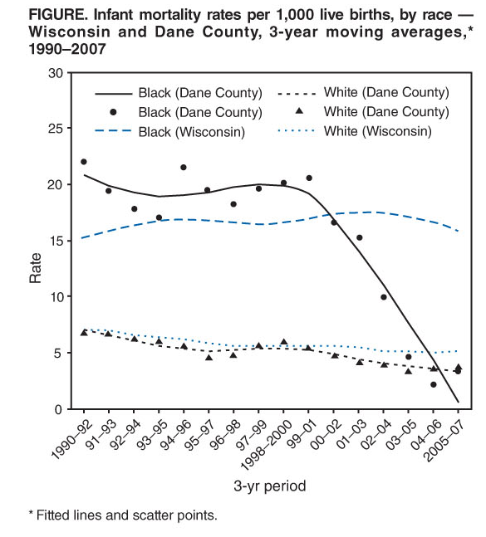
Locally Weighted
Polynomial
Regression
was used to
smooth the
trend data

Slide 60
Infant Mortality in Dane County, Wisconsin
Locally weighted smoothing is a nonparametric method—no assumption about the shape of the trend.
“neighborhoods” of data points are defined and a parametric model (e.g. linear) is assumed for this subset of points and trendlines can be drawn within each “neighborhood”. The neighborhoods can be iteratively defined, accomplishing “smoothing” across all of the iterations.

Slide 61
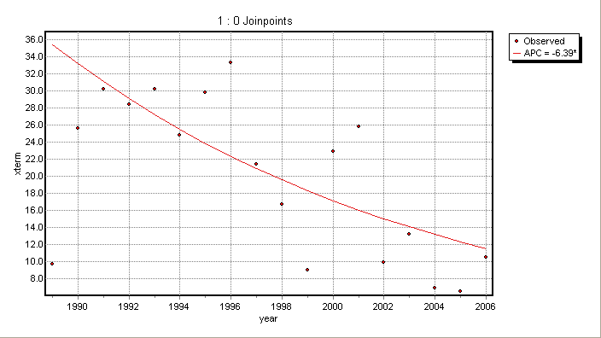
Infant Mortality in Dane County, Wisconsin
Extremely Premature African American Births
Dane County 1989-2006
Joinpoint Regression

Slide 62
Infant Mortality in Dane County, Wisconsin:
A Cautionary Tale
Wisconsin State Journal:
Posted in Health_med_fit on Sunday, July 18, 2010 8:15 am Updated: 4:41 pm. Infant Mortality Rate, Dr. Thomas Schlenker
Racial gap in infant mortality rate returns*
“Health officials, puzzled by the mixed picture, say they will investigate every infant death and hope to expand home visits to pregnant women.”
“Schlenker said the county's racial gap has returned, with three times as many black babies dying before their first birthdays as white babies - a chasm that vanished from 2003 to 2007.”
"It's not as simplistic anymore," Schlenker said. "This has become very complex.“
*Based on data for 2008-2009.

Slide 63
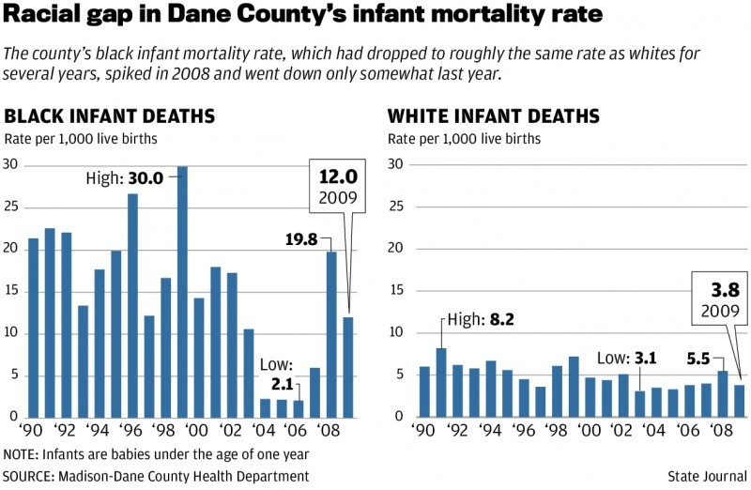
Infant Mortality in Dane County, Wisconsin:
A Cautionary Tale
Posted in Health_med_fit on Thursday, March 24, 2011 7:30 am Updated: 11:26 am.Infant Mortality, Tom Schlenker, Nicole Tyson, Meriter Hospital, Frances Huntley-cooper, Susan Wildrick, South Madison Health And Family Center, Scott Walker, Jeanan Yasiri

Slide 64
Infant Mortality in Dane County, Wisconsin:
A Cautionary Tale
“Dane County's black infant mortality rate, which dropped for several years and became a national success story, shot up again to four times the rate for whites over the past three years, leaving health officials stumped.”
He [Schlenker] said he still thinks the positive trend last decade was real, but so is the pattern for the past three years. "Unfortunately, it's not a fluke," he said.

Slide 65
Infant Mortality in Dane County, Wisconsin:
A Cautionary Tale
March 30, 2012 3:30 pm • DAVID WAHLBERG | Wisconsin State Journal |
http://host.madison.com/wsj/news/local/health_med_fit/dane-county-black-infant-mortality-rate-remains-high/article_e7e9be26-7aa5-11e1-93ec-001a4bcf887a.html
"Now that we've had several bad years, we can definitely say the positive trend has reversed itself," said Daniel Stattelman-Scanlan, perinatal supervisor at Public Health Madison and Dane County.
In 2011, the county had 16.70 deaths per 1,000 births for blacks, compared to 5.67 deaths per 1,000 births for whites.
Three-year averages for 2009 to 2011, which take into account variation in any one year, showed a similar gap: 13.91 deaths per 1,000 births for blacks, compared to 4.20 deaths per 1,000 births for whites.

Slide 66
Infant Mortality in Dane County, Wisconsin:
A Cautionary Tale
A fetal and infant mortality review committee, formed by the health department last year, is studying each death to identify patterns and opportunities for improvement.
The health department is discussing a safe sleeping campaign that could involve black churches like a similar campaign in Milwaukee.
A program to begin this summer will send nurses every week or two to the homes of high-risk, first-time mothers from early pregnancy until the children turn 2. That's a longer and more intensive program than offered now, Stattelman-Scanlan said.

