Slide 1
Presenting Multivariable Results
Saturday June 2, 10:15am-12:00pm
Kristin Rankin, PhD
Research Assistant Professor
      Division of Epidemiology and Biostatistics
      University of IL School of Public Health
Training Course in MCH Epidemiology

Slide 2
Presenting Results
Tables, charts and graphs, in addition to text, provide an effective method for communicating person, place, and time data to your audience
The organization and format of these tables, charts and graphs may differ depending on your goal and the type of results displayed (ie descriptive statistics, measures of effect, results of multivariable methods, etc)

Slide 3
Presenting Results
1. Start with the message/content you are trying to convey and identify the data that will be used
2. Consider your audience
  General Public
  Stakeholders
  Scientific Community
3. Consider the form of the data
  Prevalence estimates, distributions
  Trends over time
  Measures of association

Slide 4
Presenting Results
4. Determine if text, table, chart (what type?), or all are needed to communicate the message
5. For visuals, determine where to display each variable, which should be featured (and how?) and the best design for the remaining objects
6. For text, determine how best to interpret and communicate results and implications of results
Modified from Stephen Few’s Whitepaper “Communicating Numbers” http://www.perceptualedge.com/articles/Whitepapers/Communicating_Numbers.pdf

Slide 5
Analytic Design Principles (Tufte)
Comparisons
Causality, Mechanism, Structure, Explanation
Multivariate Analysis
Integration of evidence
Documentation
Content Counts Most of All
Edward Tufte, Beautiful Evidence, Cheshire Ct: Graphics Press, pp126-139

Slide 6
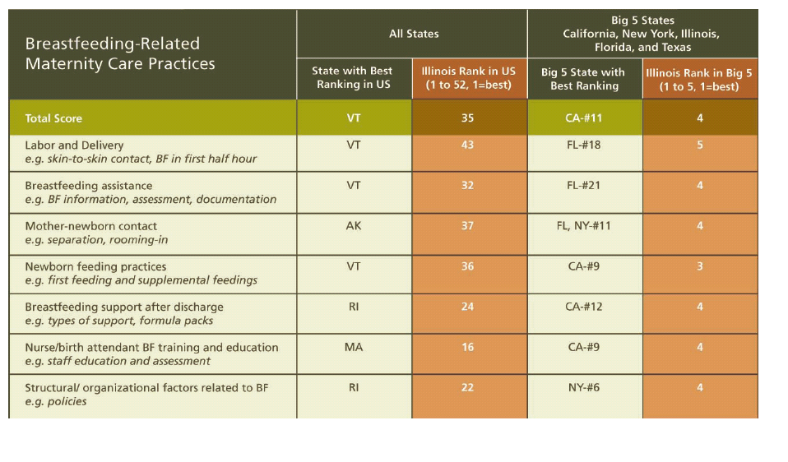
Design Principle 1: Comparisons Appropriate Comparison Groups
Notes:
Show appropriate comparisons,
contrasts, differences
Understand whether row percents or column percents more effectively make comparison
Order bars/pie pieces in charts to show comparison of interest
Display benchmarks or overall averages to provide a frame of reference when appropriat
Highlight value of interest to be compared to others, using a darker color or outline

Slide 7
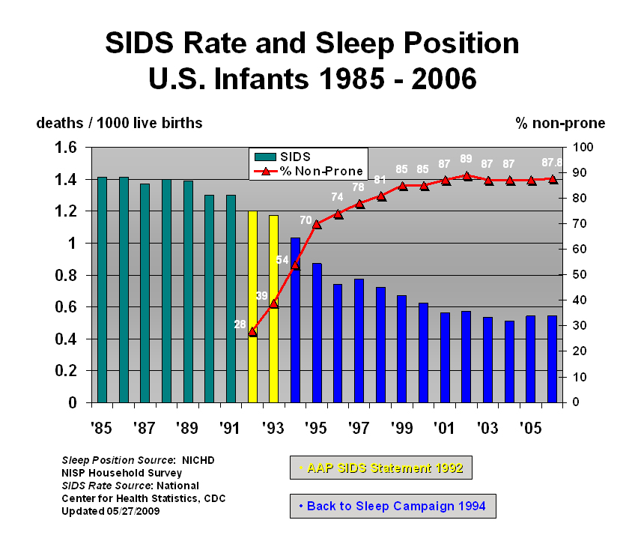
Design Principle 2: Causality, Mechanism, Structure, Explanation
http://emedicine.medscape.com/article/1004238-overview
Notes:
Highlight policies, interventions, risk factors, or changes in human behavior that may have caused a trend or association

Slide 8
Design Principle 3: Multivariate Results
Notes:
Show more than 1 or 2 variables
Use stratification to show differences across groups
Use regression modeling when appropriate to capture multivariable nature of problem
Use and communicate adjustment procedures

Slide 9
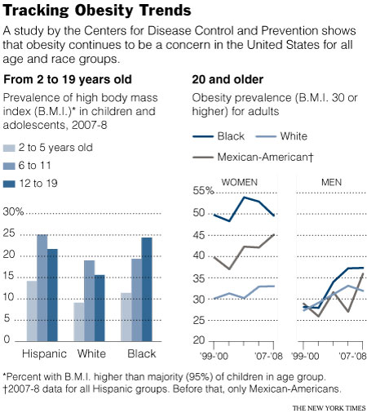
Small Multiples
How many variables are displayed in this chart?
What are they?
From: “Obesity Rates Hit Plateau in U.S., Data Suggest”
By Pam Belluck
New York Times, Published: January 13, 2010
Notes:
Minimize the time it takes audience
to figure out format
By keeping the quantitative scale consistent, graphic is easier for audience to read
Audience doesn’t need to figure out format again with each new display of information
Especially useful when there is a fourth dimension that would make a single chart too busy or difficult to interpret

Slide 10
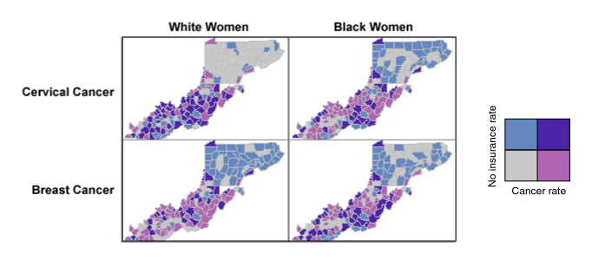
Small Multiples
In this example, we show four (bivariate!) small multiple maps of cancer rates and health insurance. Grey areas are counties with low rates of cancers and low rates of women without insurance (i.e., high rates of women having health insurance). Dark purple areas are counties with high rates of cancer and high rates of women without insurance. Using a small multiple technique for representing this data allows us to further segment the population of women by two additional variables (cancer type and race) to see if there are different spatial patterns of cancer among those segments of the total population.
https://www.e-education.psu.edu/geog486/l8_p5.html
Notes:
In this example, we show four (bivariate!) small multiple maps of cancer rates and health insurance. Grey areas are counties with low rates of cancers and low rates of women without insurance (i.e., high rates of women having health insurance). Dark purple areas are counties with high rates of cancer and high rates of women without insurance. Using a small multiple technique for representing this data allows us to further segment the population of women by two additional variables (cancer type and race) to see if there are different spatial patterns of cancer among those segments of the total population.

Slide 11
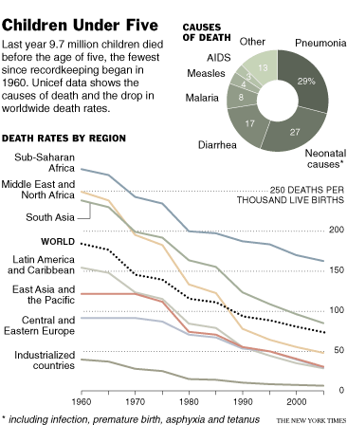
Design Principle 4: Integration of Evidence
Child Mortality at Record Low; Further Drop Seen
By DONALD G. McNEIL Jr.
Published: September 13, 2007 in the New York Times
Notes:
Completely integrate words,
numbers, images, diagrams
Use clear titles, direct labels and footnotes
Avoid legends as much as possible or put them inside the chart to maximize the chart area and keep the labels closer to the data
Blend graphical representations of data with short narrative to help with interpretation
Detail adds precision, clarity and credibility

Slide 12
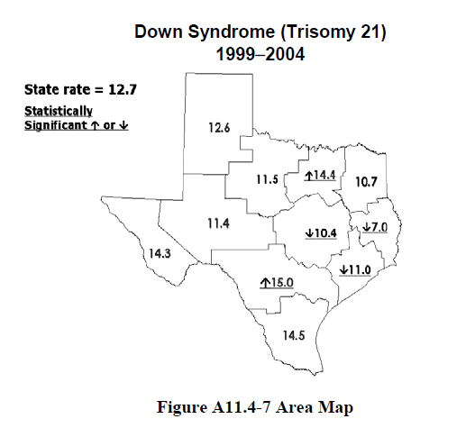
Design Principle 5: Documentation
Notes:
Thoroughly describe the evidence; important for establishing credibility
Provide a detailed title
Indicate authors and sponsors
Document data sources and years
Show complete measurement scales
Acknowledge error (confidence intervals) in estimates when appropriate
Communicate statistical significance when appropriate

Slide 13
Design Principle 6: Content Counts Most of All
Analytic presentations ultimately stand or fall depending on the quality, relevance and integrity of content
Charts/tables should be content focused, not process focused
  Simple design, rich content
  Eliminate anything that doesn’t contribute to content, including 3-D, boxes, legends, “chart junk”

Slide 14
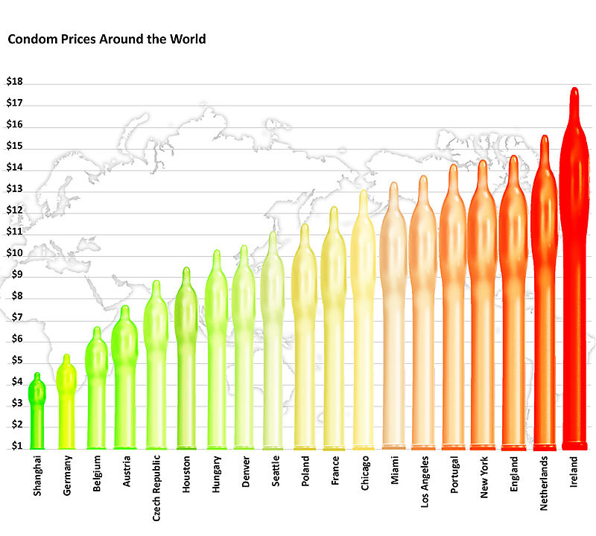
Chartjunk
http://www.presentationzen.com/presentationzen/2008/07/environmental-graffiti-posted-a-bar-chart-suitable-for-entry-into-the-bar-chart-hall-of-shame-i-made-a-list-of-at-least-ten.html
Notes:
How many ways could you improve this chart?
How many ways can you misinterpret the chart's meaning at first glance?
Issues:
signal vs. noise
contrast/affinity,
color,
area distortion,
labeling, etc.
Perhaps a simple table would lead to more clarity (and less snickering).

Slide 15
Presenting Multivariable Results
Analytic methods need not be simplistic when results are intended for a non-scientific audience; scientific rigor should be practiced regardless of the audience
It’s our job as MCH epidemiologists to deliver a clear interpretation of the results of complex methods that is appropriate for any audience

Slide 16
Presenting Multivariable Results
Work with partners, including policy makers, public health practitioners, program staff, clinicians, members of community during analysis phase and in the dissemination of results to ensure that:
Assumptions and analysis plan match needs
Results are useful and actionable
Data products are clear and linked with strategies or recommendations

Slide 17
Presenting Multivariable Results
“Consider your Audience” (slide 2) means Respect your Audience
Educate as you inform
If you never show standard errors or confidence intervals because your audience doesn’t understand them, your audience will never understand them
Notes:
Metaphor: Lawyer presenting to a jury – jurors are obligated to understand
Can’t control audience – “General public” includes everyone from consumers with no exposure to statistics to CEOs, legislators, scientists, etc.`

Slide 18
Presenting Multivariable Results
Educate as you inform
Example text for explaining “adjustment”:
Information about relationships between risk factors and maternal and child health outcomes is reported using an approach called “adjustment”. This approach accounts for differences among women that might distort what we see.
For example, the relationship between cigarette smoking and infant mortality might be distorted unless we “adjust” for the fact that smokers are often younger and have less education than non-smokers.
Notes:
Metaphor: Lawyer presenting to a jury – jurors are obligated to understand
Can’t control audience – “General public” includes everyone from consumers with no exposure to statistics to CEOs, legislators, scientists, etc.`

Slide 19
Presenting Multivariable Results
Use “Plain Language”
A plain language document-one in which people can:
  Find what they need,
  Understand what they find, and
  Act appropriately on that understanding
PLAIN LANGUAGE: A PROMISING STRATEGY FOR CLEARLY COMMUNICATING HEALTH INFORMATION AND IMPROVING HEALTH LITERACY
http://www.health.gov/communication/literacy/plainlanguage/PlainLanguage.htm

Slide 20
Presenting Multivariable Results
Plain language:
Organize information so the most important behavioral or action points come first
Break complex information into understandable chunks
Use simple language or define technical terms
Provide ample white space so pages look easy to read
Use short sentences and active voice
PLAIN LANGUAGE: A PROMISING STRATEGY FOR CLEARLY COMMUNICATING HEALTH INFORMATION AND IMPROVING HEALTH LITERACY
http://www.health.gov/communication/literacy/plainlanguage/PlainLanguage.htm

Slide 21
Balancing Clarity and Detail/Documentation
Consider a layered approach to presenting results in order to allow audience to drill down from summary points to details:
  Executive Summary
  Detailed graphs and charts with annotation and accompanying narrative/pictures
  Appendix with all underlying tables and statistical results, as well as methods and data source description, either posted online or in report
Prior to finalizing results to be disseminated, ALWAYS pilot materials with a few people from the intended audience to make sure your message is getting across as anticipated; Revise as necessary

Slide 22
Discussion: Presenting Results of Complex Analyses
(see articles)

