Slide 1
Moving Beyond Odds Ratios: Estimating and Presenting Absolute Risk Differences and Risk Ratios
Ashley H. Schempf, PhD
MCH Epidemiology Training Course
June 2, 2012

Slide 2
Acknowledgements
Jay Kaufman, PhD
McGill University
Presentation at 17th Annual MCH Epidemiology Conference
New Orleans, LA
12/14/11
Kaufman & Schempf. “Absolute Epidemiology: Developing Software Skills for Estimation of Absolute Contrasts from Regression Models for Improved Communication and Greater Public Health Impact.”

Slide 3
Outline
Problems of the Odds Ratio
  Not intuitive
  Exaggerates risk, especially for common outcomes
  Not collapsible over strata, apparent confounding
Why did we ever use it? Is it appropriate?
Absolute epidemiology
  Actual risk and numbers affected (AR, PAR, NNT)
  Additive interactions
How to calculate RD and RRs in SAS and STATA

Slide 4
Odds are….odd
We tend to think in probabilities
  3 out of 4, p=75%
Odds divide the probability by 1-p
  3 to 1 or p/(1-p)=0.75/0.25 = 3 to 1
What if outcome (p) is rare?
  1-p → 1 and p gets closer to p/(1-p)
  1 out of 10, p=10%
  1 to 9 or p/(1-p)=0.1/0.9 = 0.11 to 1

Slide 5
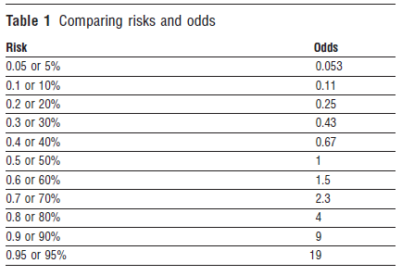
Risks versus Odds
Davies HT, Crombie IK, Tavakoli M. When can odds ratios mislead? BMJ. 1998 Mar 28;316(7136):989-91.

Slide 6
Oddness of Odds Ratios
Compare the outcomes in two groups
Odds in Group 2: P2/(1-P2)
Odds in Group 1: P1/(1-P1)
Correct Interpretation: Group 2 has (1-OR)% increased odds of outcome Y compared to Group 1
Problem: temptation to interpret as relative risks because a ratio of odds is difficult to understand; OR does not approximate RR when outcome is common
= OR

Slide 7
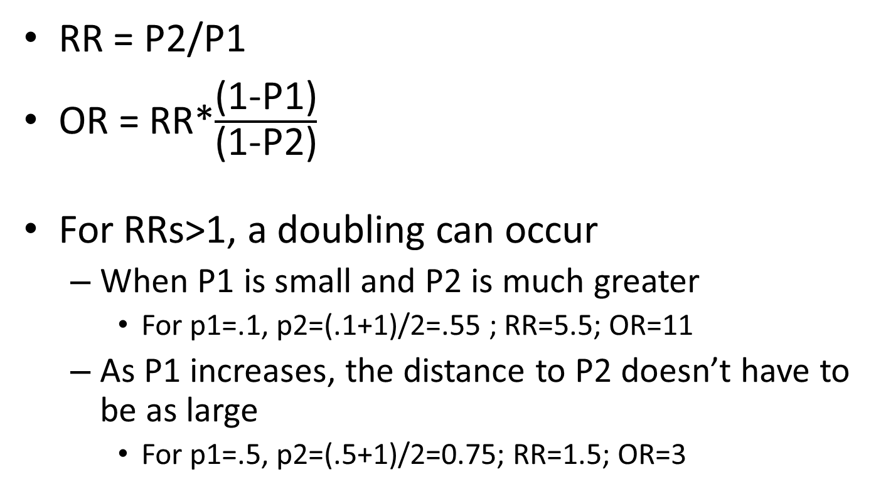
OR versus RR
RR = P2/P1
OR = RR*$\frac{\text{(1−}\text{P}\text{1)}}{\text{(1−}\text{P}\text{2)}}$
For RRs>1, a doubling can occur
  When P1 is small and P2 is much greater
    For p1=.1, p2=(.1+1)/2=.55 ; RR=5.5; OR=11
  As P1 increases, the distance to P2 doesn’t have to be as large
    For p1=.5, p2=(.5+1)/2=0.75; RR=1.5; OR=3

Slide 8
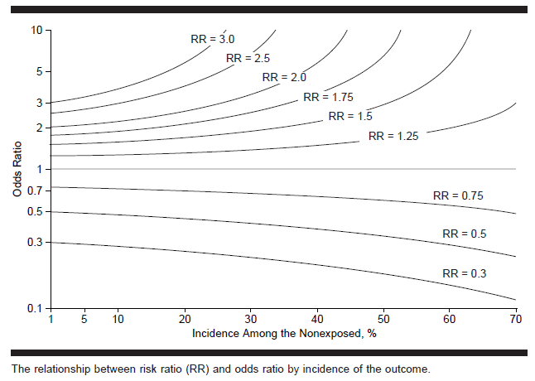
ORs will be exaggerated measures of RR
  At high prevalence levels, regardless of RR
  Even at low prevalence levels when RR is high
  So basically, when prevalence is high in at least one strata

Slide 9
Case Example
Many public health problems are not very rare
  Diabetes, Hypertension, Obesity
  RR = .50/.35 = 1.43
  OR = (0.50/0.50)/(0.35/0.65) = 1.86
Risk Factor | Outcome +
- | 35%
+ | 50%

Slide 10
Non-collapsability
Unlike the RR, the odds ratio is not collapsible, meaning that the overall odds ratio does not equal the weighted average of stratum-specific odds ratios
The overall OR is always less so it can appear that there is significant confounding when there is none

Slide 11
The observed values are:
Crude RR = 6/4 = 1.50
Crude OR = (6/4)/(4/6) = 2.25
Greatly exaggerated because overall risk is high (~50%)
Z cannot be a confounder of X because it is not associated with X, all possible combinations of Z and X have 5 observations
 | Z = 1 |  | Z = 0 |  | TOTAL
 | X = 1 | X = 0 | X = 1 | X = 0 | X = 1 | X = 0
Y = 1 | 4 | 3 | 2 | 1 | 6 | 4
Y = 0 | 1 | 2 | 3 | 4 | 4 | 6
TOTAL | 5 | 5 | 5 | 5 | 10 | 10

Slide 12
The observed effect contrast measures are therefore:
 | Z = 1 |  | Z = 0 |  | CRUDE
 | X = 1 | X = 0 | X = 1 | X = 0 | X = 1 | X = 0
RISK | 0.80 | 0.60 | 0.40 | 0.20 | 0.60 | 0.40
RISK DIFFERENCE | 0.20 |  | 0.20 |  | 0.20
RISK RATIO | 1.33 |  | 2.00 |  | 1.50
ODDS RATIO | 2.67 |  | 2.67 |  | 2.25
Adjusted RD = Crude RD
Adjusted RD = Crude RD
Adjusted OR ≠ Crude OR

Slide 13
The Odds Ratio is a LIAR
Based on the practical criteria traditionally employed for detecting confounding (i.e., a change-in-estimate approach), the decision in this example would be to adjust for covariate Z when using the OR as the effect measure but not RR or RD.
The discrepancy arises because inequality between the crude and adjusted OR does not necessarily imply causal confounding if the OR does not approximate the RR.
The odds ratio is not collapsible, meaning that the average of the stratum-specific values does not necessarily equal the crude value, even in the absence of confounding. Thus, adjusting for factors that are not confounders can make associations appear stronger based on the OR (i.e. negative confounding) but will not affect the RD or RR. Also possible for crude to equal adjusted OR when confounding is present.

Slide 14
Why did we use odds ratios?
Some convenient properties
  Symmetric, odds of Y = 1/(odds of not Y)
  OR of exposure given outcome = OR of outcome given exposure
Didn’t have the tools and modeling options
Misconception that you cannot use RR in cross-sectional studies
  Not true, it just becomes a prevalence rate ratio
  Even in case-control studies, there are ways around an OR

Slide 15
What if you’ve published ORs?
Don’t fret; qualitative inference is still the same even if magnitude is off
  If OR was positive and significant, RR will be too
  If OR was negative and significant, RR will be too
Hopefully, you did not evaluate confounding, control for non-confounders, or interpret OR as increased risks
But now, we have the tools to report what we want (risk/prevalence differences and ratios)
So, down with the odds ratio!

Slide 16
Are RRs all you need?
Unfortunately, all ratio-based measures can be misleading whether or not they’re based on odds or probabilities
Take, for example, a relative risk of 2
  A doubling of risk sounds dramatic
  1% to 2%, RR=2 but absolute increase is 1%, still very unlikely to have outcome Y
  30% to 60%, RR=2 but absolute increase is 30%, now more likely than not to have outcome Y

Slide 17
Absolute Epidemiology
Absolute risk/prevalence differences carry advantage of assessing actual impact
  Potentially avertable or excess cases
  Number needed to treat, PARF
  Additive interactions
Some believe we should abandon ratio based measures of association altogether

Slide 18
Teaching Example
Kaufman JS. Toward a more disproportionate epidemiology. Epidemiology 2010 Jan;21(1):1-2.
Department Chair wants to evaluate the effectiveness of instruction
Professor X conducts an RCT
Treatment Group Control Group
(n=30) (n=30)
Passed 18 6
Failed 12 24
Total 30 30
Pass Rate tripled with instruction: 18/6 = 3

Slide 19
Teaching Example, cont.
The economy shifted and drove smarter students back to school as job opportunities were more limited (baseline pass rate increased)
Treatment Group Control Group
(n=30) (n=30)
Passed 24 8
Failed 16 22
Total 30 30
Ratio measure of effectiveness controls for baseline changes
RR = 24/8 = 3

Slide 20
Teaching Example, cont
Professor argues that it’s better to be rewarded based on absolute number of students who passed with the aid of instruction
  Period 1: 18 – 6 = 12
  Period 2: 24 – 8 = 16
However, this increased during the economy due to the talent of the student pool and not due to improvements in teaching effectiveness
Ratio measures help to control for baseline differences so that comparisons examine treatment effects rather than compositional differences

Slide 21
Teaching Example, cont.
No one can deny that in the first assessment, 12 more students passed as a result of instruction
Or that 18 more students passed as a result of instruction in the second assessment
But to compare teaching effectiveness across the two assessments requires an adjustment for baseline pass rates

Slide 22
Inconsistencies between Absolute and Relative Differences
When evaluating the effect of a single factor within one group or time period, there is qualitative concordance
  A positive RD will correspond with RR>1
  A negative RD will correspond with RR<1
However, indicators can be inconsistent when comparing the effect in two groups or time periods (interactions)
  In teaching example, absolute measures differed over time while RR remained constant

Slide 23
Disparity Assessment Over Time:
Decreasing Rates of a Negative Outcome
Absolute Disparity Declines but Relative Disparity Increases
Absolute Disparity (RD): 5 to 4
Relative Disparity (RR): 2 to 3

Slide 24
Disparity Assessment Over Time:
Decreasing Rates of a Negative Outcome
Optimal Disparity Reduction: Both Absolute and Relative Disparities ↓
Absolute Disparity (RD): 5 to 2
Relative Disparity (RR): 2 to 1.67
When rates are declining, a RR ↓ always corresponds to RD ↓

Slide 25
Disparity Assessment Over Time:
Increasing Rates of a Positive Outcome
Absolute Disparity Does Not Change and Relative Disparity ↓
Absolute Disparity (RD): 20 to 20
Relative Disparity (RR): 1.33 to 1.11

Slide 26
Disparity Assessment Over Time:
Increasing Rates of a Positive Outcome
Optimal Disparity Reduction: Both Absolute and Relative Disparities ↓
Absolute Disparity (RD): 20 to 10
Relative Disparity (RR): 1.33 to 1.13
When rates are increasing, a RD ↓ always corresponds to RR ↓

Slide 27
Healthy People
Decline in both absolute and relative differences is best evidence of progress in disparity elimination
Relative measures of disparity are primary indicator of progress because they adjust for changes in the level of the reference point over time
Relative measures also have advantage of adjusting for differences in reference point when comparisons are made across objectives
Keppel KG, Pearcy JN, Klein RJ. Measuring progress in Healthy People 2010. Healthy People 2010 Stat Notes. 2004 Sep;(25):1-16.

Slide 28
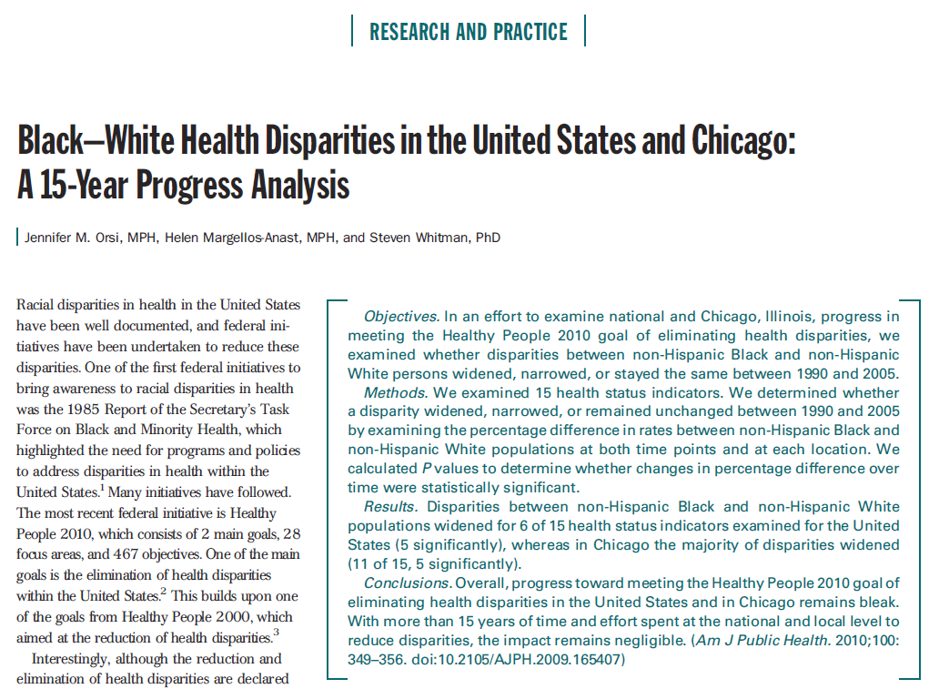
2) Ratio Measures Can’t Be Easily Compared

Slide 29
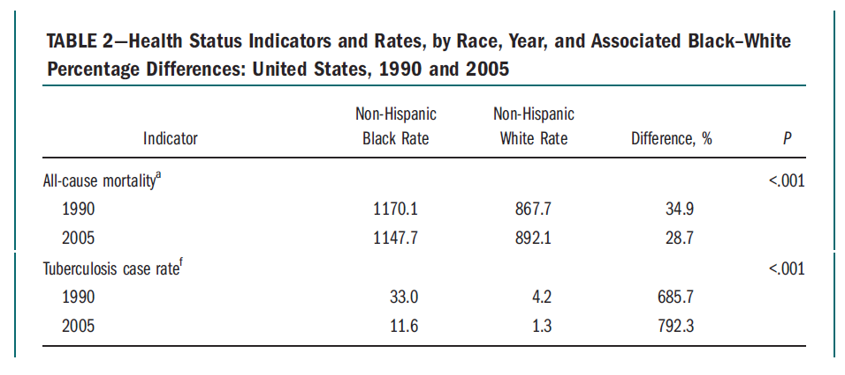
÷ =
÷ =
33.0 – 4.2 = 28.8
per 100,000 population
11.6 – 1.3 = 10.3

Slide 30
Additive versus Multiplicative Interaction
Multiplicative interaction may be an extreme standard; cases where multiplicative interaction is not present but additive is with important public health implications
Stroke Incidence per 1,000 | Smoke - | Smoke + |  | Risk Difference |  |  | Relative Risk
OC Pill - | 10 | 30 |  | - | 20 |  | - | 3
OC Pill + | 20 | 60 |  | 10 | 50 |  | 2 | 6
Joint effects exhibit additive interaction: increase of 50 cases versus expected 30
Multiplicative interaction not present, 3*2=6, RR of 6 expected and observed
Same as Teaching Example, but that was different assessments of the same factor—teaching effectiveness—that may have warranted a ratio measure to control for baseline differences over time

Slide 31
Why both absolute and relative measures matter
Absolute measures quantify actual risks and number affected
  Necessary to evaluate/interpret the meaning of a given RR
Relative measures allow standardized comparisons across groups, time periods, indicators
Lack of correspondence creates controversy of which is “better” but they provide complementary information

Slide 32
Accurate Media Reporting
Starts with researchers presenting appropriate statistics and understanding their own data
Bad example – Schulman et al, NEJM 1999
Good example – Chen et al, JAMA 2011

Slide 33
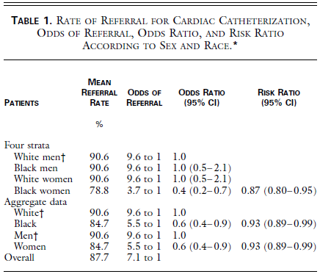
Disparities in Cardiac Catheterization
Odds Ratios were interpreted as Risk Ratios (large discrepancy due to common outcome)
Universal effects of race and sex were purported when the only difference was for Black women
  No effect of sex among Whites
  No effect of race among Men
Wide mischaracterization of results in the media

Slide 34
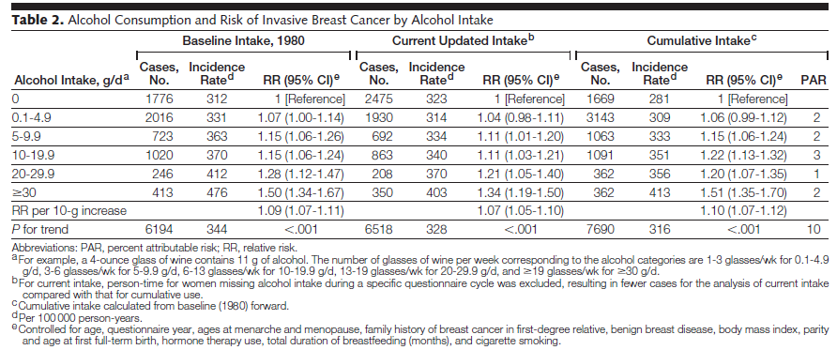
Alcohol Use and Breast Cancer
Appropriately interpreted as a 50% increase in breast cancer risk comparing 0 daily intake to 2+ drinks/day, translating to a 1.3% increase in the incidence of breast cancer over 10 years
“while the increased risk found in this study is real, it is quite small. Women will need to weigh this slight increase in breast cancer risk with the beneficial effects alcohol is known to have on heart heath, said Dr. Wendy Chen, of Brigham and Women's Hospital in Boston. Any woman's decision will likely factor in her risk of either disease, Chen said.” MSNBC

Slide 35
Estimation Options for
Risk Differences and Risk Ratios
Showing code in STATA and SAS
Examples with non-sampled and complex survey data

Slide 36
Model Options
Linear Probability Model
Generalized Linear Model (Binomial, Poisson)
Logistic Model (probability conversions)

Slide 37
Simple Data Example
Linked Birth Infant Death Data Set, 2004
  Data from several cities
  Outcome: Preterm Birth (<37 weeks gestation)
  Covariates: Marital status, race/ethnicity, maternal age
Example applies to cohort or cross-sectional data generally and population-level (non-sampled) or simple random samples

Slide 38
Tabular Risk Differences (STATA):
. cs ptb unmar, by(race) istandard rd
race | RD [95% CI]
-----------------+------------------------------
NH WHITE | 0.0376 0.0251, 0.0501
NH BLACK | 0.0394 0.0218, 0.0570
HISPANIC | 0.0187 0.0091, 0.0283
OTHER | 0.0174 -0.0061, 0.0408
-----------------+------------------------------
Crude | 0.0387 0.0324, 0.0451
I. Standardized | 0.0281 0.0208, 0.0355
But tabular approaches are limited:
  Can only adjust for 1-2 categorical confounders
  Difficult to handle continuous exposures/covariates
  Difficult to handle clustered data, other extensions
So we need to take a regression-based approach…

Slide 39
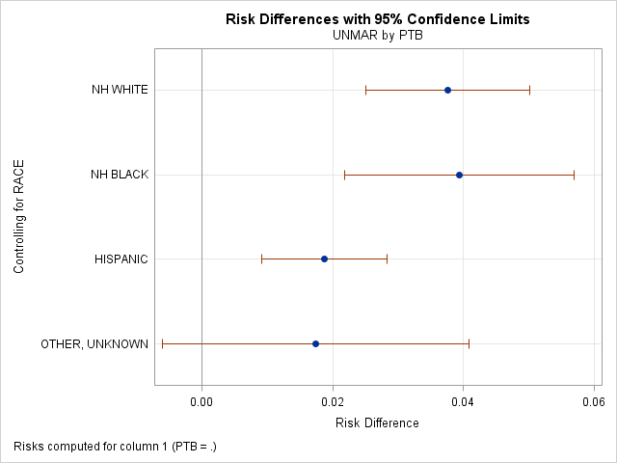
SAS Tabular
proc freq;
table race*unmar*ptb/relrisk riskdiff cmh;
format race race.;
run;
Adjusted RR
Type of Study Method Value 95% Confidence Limits
Cohort Mantel-Haenszel 1.2149 1.1588 1.2737

Slide 40
Linear Probability Model:
Advantages: very easy to fit
single uniform estimate of RD
economists will love you
Disadvantages: possible to get impossible estimates
does not directly estimate RR
biostatisticians will hate you
Fit an OLS linear regression on the binary outcome variable:
Pr(Y=1|X=x) = β₀ + β₁X
Note: Homoskedasticity assumption cannot be met, since
variance is a function of p. Therefore, use robust variance.

Slide 41
regress ptb unmar c.mager##c.mager i.race, vce(robust) cformat(%6.4f)
Linear regression Number of obs = 47157
F( 6, 47150) = 66.28
Prob > F = 0.0000
R-squared = 0.0098
Root MSE = .35008
------------------------------------------------------------------------------
| Robust
ptb | Coef. Std. Err. t P>|t| [95% Conf. Interval]
-------------+----------------------------------------------------------------
unmar | 0.0333 0.0038 8.82 0.000 0.0259 0.0407
mager | -0.0139 0.0022 -6.18 0.000 -0.0183 -0.0095
|
c.mager#|
c.mager | 0.0003 0.0000 7.14 0.000 0.0002 0.0004
|
race |
2 | 0.0610 0.0052 11.82 0.000 0.0509 0.0712
3 | 0.0015 0.0038 0.39 0.698 -0.0060 0.0090
4 | -0.0046 0.0066 -0.70 0.482 -0.0174 0.0082
|
_cons | 0.2696 0.0309 8.72 0.000 0.2090 0.3302
------------------------------------------------------------------------------
Adjusted RD for marital status =
0.0333 (95% CI: 0.0259, 0.0407)

Slide 42
Can use a post-estimation command to see what the RD is relative to the PTB probability for married women (p=0.1249)
~27% increased risk of PTB compared to the overall probability among married women
  - Crude proxy because there was no error incorporated for the probability among married women and it’s not adjusted for other factors in the model

Slide 43
proc surveyreg order=formatted;
class race;
model ptb = unmar mager mager2 race /clparm solution;
format race race.;
run;
Adjusted RD for marital status =
0.0333 (95% CI 0.0259 , 0.0407)
Same results as in Stata
Estimated Regression Coefficients
Parameter | Estimate | Standard Error | t Value | Pr > |t| | 95% Confidence Interval
Intercept | 0.2695946 | 0.03090057 | 8.72 | <.0001 | 0.2090290 | 0.3301601
UNMAR | 0.0332760 | 0.00377112 | 8.82 | <.0001 | 0.0258845 | 0.0406674
MAGER | -0.0138969 | 0.00224696 | -6.18 | <.0001 | -0.0183010 | -0.0094929
mager2 | 0.0002888 | 0.00004043 | 7.14 | <.0001 | 0.0002096 | 0.0003681
RACE a OTHER, UNKNOWN | -0.0046041 | 0.00655092 | -0.70 | 0.4822 | -0.0174440 | 0.0082358
RACE b HISPANIC | 0.0014920 | 0.00384777 | 0.39 | 0.6982 | -0.0060497 | 0.0090337
RACE c NH BLACK | 0.0610394 | 0.00516551 | 11.82 | <.0001 | 0.0509149 | 0.0711639
RACE d NH WHITE | 0.0000000 | 0.00000000 | . | . | 0.0000000 | 0.0000000

Slide 44
Testing an Additive Interaction Between UNMAR & RACE
proc surveyreg order=formatted;
class unmar race;
model ptb = unmar mager mager2 race unmar*race /clparm solution;
slice unmar*race / sliceby(race='b HISPANIC') diff;
format unmar yn. race race.;
run;
There is a significant additive interaction; the adverse effect of being unmarried is lower among Hispanic women relative to non-Hispanic White women
Estimated Regression Coefficients
Parameter | Estimate | Standard Error | t Value | Pr > |t| | 95% Confidence Interval
Intercept | 0.2647870 | 0.03093304 | 8.56 | <.0001 | 0.2041578 | 0.3254162
UNMAR a YES | 0.0473800 | 0.00669524 | 7.08 | <.0001 | 0.0342572 | 0.0605027
UNMAR b NO | 0.0000000 | 0.00000000 | . | . | 0.0000000 | 0.0000000
MAGER | -0.0139446 | 0.00224725 | -6.21 | <.0001 | -0.0183493 | -0.0095400
mager2 | 0.0002914 | 0.00004044 | 7.20 | <.0001 | 0.0002121 | 0.0003706
RACE a OTHER, UNKNOWN | 0.0034756 | 0.00838024 | 0.41 | 0.6783 | -0.0129498 | 0.0199010
RACE b HISPANIC | 0.0125244 | 0.00485772 | 2.58 | 0.0099 | 0.0030032 | 0.0220456
RACE c NH BLACK | 0.0554741 | 0.00820734 | 6.76 | <.0001 | 0.0393876 | 0.0715606
RACE d NH WHITE | 0.0000000 | 0.00000000 | . | . | 0.0000000 | 0.0000000
UNMAR*RACE a YES a OTHER, UNKNOWN | -0.0228014 | 0.01354734 | -1.68 | 0.0924 | -0.0493544 | 0.0037515
UNMAR*RACE a YES b HISPANIC | -0.0257862 | 0.00808422 | -3.19 | 0.0014 | -0.0416314 | -0.0099410
UNMAR*RACE a YES c NH BLACK | -0.0008526 | 0.01099277 | -0.08 | 0.9382 | -0.0223986 | 0.0206934

Slide 45
Additive Interaction Between UNMAR & RACE
Effect of Being Unmarried Among non-Hispanic White Women (reference group)
The Slice statement (or contrast/estimate) can combine coefficients to obtain the effect among Hispanic women (0.04748 – 0.02579 = 0.02159)
So being unmarried increases the probability of PTB by 4.7% among non-Hispanic Whites versus 2.2% among Hispanics
Estimated Regression Coefficients
Parameter | Estimate | Standard Error | t Value | Pr > |t| | 95% Confidence Interval
UNMAR a YES | 0.0473800 | 0.00669524 | 7.08 | <.0001 | 0.0342572 | 0.0605027
Simple Differences of UNMAR*RACE Least Squares Means
Slice | UNMAR | _UNMAR | Estimate | Standard Error | DF | t Value | Pr > |t|
RACE b HISPANIC | a YES | b NO | 0.02159 | 0.005019 | 47156 | 4.30 | <.0001

Slide 46
2) Generalized Linear Model:
Advantages: single uniform estimate
biostatisticians will love you
Disadvantages: can be difficult to fit
still possible to get impossible values
Fit a GLM with a binomial or Poisson distribution
For RD: identity link
For RR: log link
g[Pr(Y=1|X=x)] = β₀ + β₁X
Generally fit Poisson when binomial fails to converge, must use robust standard errors due to binary data
Spiegelman D, Hertzmark E. Easy SAS calculations for risk or prevalence ratios and differences. Am J Epidemiol 2005 Aug 1;162(3):199-200.

Slide 47
glm ptb unmar c.mager##c.mager i.race, fam(binomial) lin(identity) cformat(%6.4f)
binreg ptb unmar c.mager##c.mager i.race, rd cformat(%6.4f)
Generalized linear models No. of obs = 47157
Optimization : MQL Fisher scoring Residual df = 47150
(IRLS EIM) Scale parameter = 1
Deviance = 38557.57844 (1/df) Deviance = .8177641
Pearson = 47156.96255 (1/df) Pearson = 1.000148
Variance function: V(u) = u*(1-u) [Bernoulli]
Link function : g(u) = u [Identity]
BIC = -468834.8
------------------------------------------------------------------------------
| EIM
ptb | Risk Diff. Std. Err. z P>|z| [95% Conf. Interval]
-------------+----------------------------------------------------------------
unmar | 0.0304 0.0037 8.29 0.000 0.0233 0.0376
mager | -0.0138 0.0022 -6.33 0.000 -0.0180 -0.0095
|
c.mager#|
c.mager | 0.0003 0.0000 7.19 0.000 0.0002 0.0004
|
race |
2 | 0.0608 0.0051 11.84 0.000 0.0507 0.0709
3 | 0.0021 0.0038 0.55 0.581 -0.0053 0.0095
4 | -0.0034 0.0065 -0.53 0.599 -0.0162 0.0093
|
_cons | 0.2722 0.0299 9.12 0.000 0.2137 0.3307
------------------------------------------------------------------------------

Slide 48
glm ptb unmar c.mager##c.mager i.race, fam(binomial) lin(log) eform
binreg ptb unmar c.mager##c.mager i.race, rr cformat(%6.4f)
Generalized linear models No. of obs = 47157
Optimization : MQL Fisher scoring Residual df = 47150
(IRLS EIM) Scale parameter = 1
Deviance = 38541.14486 (1/df) Deviance = .8174156
Pearson = 47198.70916 (1/df) Pearson = 1.001033
Variance function: V(u) = u*(1-u/1) [Binomial]
Link function : g(u) = ln(u) [Log]
BIC = -468851.2
------------------------------------------------------------------------------
| EIM
ptb | Risk Ratio Std. Err. z P>|z| [95% Conf. Interval]
-------------+----------------------------------------------------------------
unmar | 1.2733 0.0336 9.16 0.000 1.2092 1.3408
mager | 0.9184 0.0118 -6.64 0.000 0.8957 0.9418
|
c.mager#|
c.mager | 1.0018 0.0002 7.90 0.000 1.0013 1.0022
|
race |
2 | 1.4499 0.0459 11.72 0.000 1.3626 1.5428
3 | 1.0098 0.0295 0.33 0.739 0.9535 1.0694
4 | 0.9632 0.0498 -0.72 0.469 0.8703 1.0661
------------------------------------------------------------------------------

Slide 49
Risk Difference, Identity Link
proc genmod descending;
class race/order=formatted;
model ptb = unmar mager mager2 race / dist=bin link=identity;
format race race.;
run;
Adjusted RD for marital status =
0.0304 (95% CI 0.0233 , 0.0375)
Analysis Of Maximum Likelihood Parameter Estimates
Parameter |  | DF | Estimate | Standard Error | Wald 95% Confidence Limits |  | Wald Chi-Square | Pr > ChiSq
Intercept |  | 1 | 0.2722 | 0.0293 | 0.2148 | 0.3296 | 86.49 | <.0001
UNMAR |  | 1 | 0.0304 | 0.0036 | 0.0233 | 0.0375 | 70.67 | <.0001
MAGER |  | 1 | -0.0138 | 0.0021 | -0.0180 | -0.0096 | 41.33 | <.0001
mager2 |  | 1 | 0.0003 | 0.0000 | 0.0002 | 0.0004 | 52.96 | <.0001
RACE | a OTHER, UNKNOWN | 1 | -0.0034 | 0.0065 | -0.0161 | 0.0092 | 0.28 | 0.5969
RACE | b HISPANIC | 1 | 0.0021 | 0.0038 | -0.0053 | 0.0095 | 0.31 | 0.5782
RACE | c NH BLACK | 1 | 0.0608 | 0.0051 | 0.0507 | 0.0709 | 140.23 | <.0001
RACE | d NH WHITE | 0 | 0.0000 | 0.0000 | 0.0000 | 0.0000 | . | .
Scale |  | 0 | 1.0000 | 0.0000 | 1.0000 | 1.0000

Slide 50
Relative Risk, Log Link
proc genmod descending;
class race/order=formatted;
model ptb = unmar mager mager2 race / dist=bin link=log;
estimate 'RR unmar' unmar 1 /exp;
format race race.;
run;
Adjusted RR for marital status =
1.27 (95% CI 1.21, 1.34)
Analysis Of Maximum Likelihood Parameter Estimates
Parameter |  | DF | Estimate | Standard Error | Wald 95% Confidence Limits |  | Wald Chi-Square | Pr > ChiSq
Intercept |  | 1 | -1.2273 | 0.1810 | -1.5819 | -0.8726 | 45.99 | <.0001
UNMAR |  | 1 | 0.2416 | 0.0265 | 0.1897 | 0.2934 | 83.38 | <.0001
MAGER |  | 1 | -0.0851 | 0.0129 | -0.1103 | -0.0598 | 43.53 | <.0001
mager2 |  | 1 | 0.0018 | 0.0002 | 0.0013 | 0.0022 | 61.80 | <.0001
RACE | a OTHER, UNKNOWN | 1 | -0.0374 | 0.0517 | -0.1389 | 0.0640 | 0.52 | 0.4693
RACE | b HISPANIC | 1 | 0.0097 | 0.0293 | -0.0477 | 0.0671 | 0.11 | 0.7398
RACE | c NH BLACK | 1 | 0.3715 | 0.0317 | 0.3093 | 0.4337 | 136.94 | <.0001
RACE | d NH WHITE | 0 | 0.0000 | 0.0000 | 0.0000 | 0.0000 | . | .
Contrast Estimate Results
Label | Mean Estimate | Mean |  | L'Beta Estimate | Standard Error | Alpha | L'Beta |  | Chi-Square | Pr > ChiSq
 |  | Confidence Limits |  |  |  |  | Confidence Limits
RR unmar | 1.2733 | 1.2089 | 1.3410 | 0.2416 | 0.0265 | 0.05 | 0.1897 | 0.2934 | 83.38 | <.0001

Slide 51
For Modified Poisson, generate a unique id number in data step id=_n_;
Generally only used when binomial model fails to converge because it is less efficient
proc genmod descending data=nola_cohort;
class id race;
model ptb = unmar mager mager2 race / dist=poisson link=identity;
repeated subject=id/type=ind;
format race race.;
run;
Analysis Of GEE Parameter Estimates
Empirical Standard Error Estimates
Parameter |  | Estimate | Standard Error | 95% Confidence Limits |  | Z | Pr > |Z|
Intercept |  | 0.2720 | 0.0305 | 0.2123 | 0.3318 | 8.92 | <.0001
UNMAR |  | 0.0299 | 0.0037 | 0.0226 | 0.0372 | 8.04 | <.0001
MAGER |  | -0.0137 | 0.0022 | -0.0180 | -0.0093 | -6.19 | <.0001
mager2 |  | 0.0003 | 0.0000 | 0.0002 | 0.0004 | 7.04 | <.0001
RACE | a OTHER, UNKNOWN | -0.0033 | 0.0065 | -0.0161 | 0.0096 | -0.50 | 0.6182
RACE | b HISPANIC | 0.0022 | 0.0038 | -0.0053 | 0.0097 | 0.57 | 0.5698
RACE | c NH BLACK | 0.0607 | 0.0051 | 0.0506 | 0.0707 | 11.82 | <.0001
RACE | d NH WHITE | 0.0000 | 0.0000 | 0.0000 | 0.0000 | . | .

Slide 52
proc genmod descending data=nola_cohort;
class id race;
model ptb = unmar mager mager2 race / dist=poisson link=log ;
repeated subject=id/type=ind;
estimate "RR unmar" unmar 1 /exp;
format race race.;
run;
Poisson results are very similar
Analysis Of GEE Parameter Estimates
Empirical Standard Error Estimates
Parameter |  | Estimate | Standard Error | 95% Confidence Limits |  | Z | Pr > |Z|
Intercept |  | -1.2163 | 0.1840 | -1.5769 | -0.8557 | -6.61 | <.0001
UNMAR |  | 0.2378 | 0.0268 | 0.1852 | 0.2904 | 8.87 | <.0001
MAGER |  | -0.0854 | 0.0131 | -0.1110 | -0.0598 | -6.54 | <.0001
mager2 |  | 0.0018 | 0.0002 | 0.0013 | 0.0022 | 7.78 | <.0001
RACE | a OTHER, UNKNOWN | -0.0361 | 0.0518 | -0.1377 | 0.0655 | -0.70 | 0.4861
RACE | b HISPANIC | 0.0108 | 0.0295 | -0.0470 | 0.0685 | 0.37 | 0.7146
RACE | c NH BLACK | 0.3710 | 0.0319 | 0.3085 | 0.4335 | 11.63 | <.0001
RACE | d NH WHITE | 0.0000 | 0.0000 | 0.0000 | 0.0000 | . | .
Contrast Estimate Results
Label | Mean Estimate | Mean |  | L'Beta Estimate | Standard Error | Alpha | L'Beta |  | Chi-Square | Pr > ChiSq
 |  | Confidence Limits |  |  |  |  | Confidence Limits
RR unmar | 1.2685 | 1.2035 | 1.3369 | 0.2378 | 0.0268 | 0.05 | 0.1852 | 0.2904 | 78.61 | <.0001

Slide 53
Additive versus Multiplicative Interaction
We tested additive in the LPM (OLS) but will do again here in GLM
proc genmod descending;
class unmar race/order=formatted;
model ptb = unmar mager mager2 race unmar*race/ dist=bin link=identity;
slice unmar*race / sliceby(race='b HISPANIC') diff ;
format unmar yn. race race.;
run;
Analysis Of Maximum Likelihood Parameter Estimates
Parameter |  |  | DF | Estimate | Standard Error | Wald 95% Confidence Limits |  | Wald Chi-Square | Pr > ChiSq
Intercept |  |  | 1 | 0.2686 | 0.0293 | 0.2112 | 0.3260 | 84.13 | <.0001
UNMAR | a YES |  | 1 | 0.0437 | 0.0065 | 0.0309 | 0.0566 | 44.66 | <.0001
UNMAR | b NO |  | 0 | 0.0000 | 0.0000 | 0.0000 | 0.0000 | . | .
MAGER |  |  | 1 | -0.0138 | 0.0021 | -0.0180 | -0.0096 | 41.69 | <.0001
mager2 |  |  | 1 | 0.0003 | 0.0000 | 0.0002 | 0.0004 | 53.80 | <.0001
RACE | a OTHER, UNKNOWN |  | 1 | 0.0037 | 0.0083 | -0.0126 | 0.0200 | 0.20 | 0.6554
RACE | b HISPANIC |  | 1 | 0.0109 | 0.0048 | 0.0015 | 0.0203 | 5.19 | 0.0228
RACE | c NH BLACK |  | 1 | 0.0540 | 0.0082 | 0.0380 | 0.0700 | 43.70 | <.0001
RACE | d NH WHITE |  | 0 | 0.0000 | 0.0000 | 0.0000 | 0.0000 | . | .
UNMAR*RACE | a YES | a OTHER, UNKNOWN | 1 | -0.0224 | 0.0135 | -0.0489 | 0.0040 | 2.77 | 0.0962
UNMAR*RACE | a YES | b HISPANIC | 1 | -0.0233 | 0.0080 | -0.0390 | -0.0076 | 8.45 | 0.0037
UNMAR*RACE | a YES | c NH BLACK | 1 | 0.0010 | 0.0110 | -0.0205 | 0.0225 | 0.01 | 0.9300
UNMAR*RACE | a YES | d NH WHITE | 0 | 0.0000 | 0.0000 | 0.0000 | 0.0000 | . | .
Simple Differences of UNMAR*RACE Least Squares Means
Slice | UNMAR | _UNMAR | Estimate | Standard Error | z Value | Pr > |z|
RACE b HISPANIC | a YES | b NO | 0.02044 | 0.004997 | 4.09 | <.0001

Slide 54
Additive versus Multiplicative Interaction
Now test multiplicative in a log link model
proc genmod descending;
class unmar race/order=formatted;
model ptb = unmar mager mager2 race unmar*race/ dist=bin link=log;
estimate "RR unmar, White" unmar 1 -1 unmar*race 0 0 0 1 0 0 0 -1/exp;
estimate "RR unmar, Hispanic" unmar 1 -1 unmar*race 0 1 0 0 0 -1 0 0/exp;
format unmar yn. race race.;
run;
Analysis Of Maximum Likelihood Parameter Estimates
Parameter |  |  | DF | Estimate | Standard Error | Wald 95% Confidence Limits |  | Wald Chi-Square | Pr > ChiSq
Intercept |  |  | 1 | -1.2672 | 0.1815 | -1.6229 | -0.9115 | 48.75 | <.0001
UNMAR | a YES |  | 1 | 0.3502 | 0.0463 | 0.2594 | 0.4410 | 57.15 | <.0001
UNMAR | b NO |  | 0 | 0.0000 | 0.0000 | 0.0000 | 0.0000 | . | .
MAGER |  |  | 1 | -0.0854 | 0.0129 | -0.1107 | -0.0602 | 43.92 | <.0001
mager2 |  |  | 1 | 0.0018 | 0.0002 | 0.0014 | 0.0022 | 62.95 | <.0001
RACE | a OTHER, UNKNOWN |  | 1 | 0.0249 | 0.0709 | -0.1139 | 0.1638 | 0.12 | 0.7249
RACE | b HISPANIC |  | 1 | 0.0955 | 0.0400 | 0.0171 | 0.1739 | 5.70 | 0.0170
RACE | c NH BLACK |  | 1 | 0.3905 | 0.0521 | 0.2884 | 0.4926 | 56.19 | <.0001
RACE | d NH WHITE |  | 0 | 0.0000 | 0.0000 | 0.0000 | 0.0000 | . | .
UNMAR*RACE | a YES | a OTHER, UNKNOWN | 1 | -0.1584 | 0.1039 | -0.3620 | 0.0453 | 2.32 | 0.1274
UNMAR*RACE | a YES | b HISPANIC | 1 | -0.1842 | 0.0584 | -0.2987 | -0.0696 | 9.93 | 0.0016
UNMAR*RACE | a YES | c NH BLACK | 1 | -0.0838 | 0.0672 | -0.2155 | 0.0480 | 1.55 | 0.2128
UNMAR*RACE | a YES | d NH WHITE | 0 | 0.0000 | 0.0000 | 0.0000 | 0.0000 | . | .
Contrast Estimate Results
Label | Mean Estimate | Mean |  | L'Beta Estimate | Standard Error | Alpha | L'Beta |  | Chi-Square | Pr > ChiSq
 |  | Confidence Limits |  |  |  |  | Confidence Limits
RR unmar, White | 1.4194 | 1.2962 | 1.5543 | 0.3502 | 0.0463 | 0.05 | 0.2594 | 0.4410 | 57.15 | <.0001
RR unmar, Hispanic | 1.1806 | 1.0953 | 1.2726 | 0.1660 | 0.0383 | 0.05 | 0.0910 | 0.2410 | 18.82 | <.0001

Slide 55
Additive versus Multiplicative Interaction
In this example, there was both an additive and multiplicative interaction
A multiplicative interaction necessitates an additive interaction
Regardless of scale, the effect of marital status on PTB is lower among Hispanics than non-Hispanic Whites or Blacks
Contrast Estimate Results
Label | Mean Estimate | Mean |  | Chi-Square | Pr > ChiSq
 |  | Confidence Limits
RD unmar, White | 0.0437 | 0.0309 | 0.0566 | 44.66 | <.0001
RD unmar, Black | 0.0447 | 0.0269 | 0.0625 | 24.27 | <.0001
RD unmar, Hispanic | 0.0204 | 0.0106 | 0.0302 | 16.73 | <.0001
Contrast Estimate Results
Label | Mean Estimate | Mean |  | L'Beta Estimate | Standard Error | Alpha | L'Beta |  | Chi-Square | Pr > ChiSq
 |  | Confidence Limits |  |  |  |  | Confidence Limits
RR unmar, White | 1.4194 | 1.2962 | 1.5543 | 0.3502 | 0.0463 | 0.05 | 0.2594 | 0.4410 | 57.15 | <.0001
RR unmar, Black | 1.3053 | 1.1796 | 1.4444 | 0.2665 | 0.0517 | 0.05 | 0.1652 | 0.3677 | 26.60 | <.0001
RR unmar, Hispanic | 1.1806 | 1.0953 | 1.2726 | 0.1660 | 0.0383 | 0.05 | 0.0910 | 0.2410 | 18.82 | <.0001

Slide 56
3) Logistic Regression or Probit Regression Model:
Advantages: always fits easily
can never get impossible estimates
epidemiologists will love you
Disadvantages: does not give a single uniform estimate
choose between different formulations
Fit a standard logistic regression model:
then just obtain and contrast the predicted probabilities:

Slide 57
logit ptb unmar c.mager##c.mager i.race, cformat(%6.4f) nolog
Logistic regression Number of obs = 47157
Log likelihood = -19272.104
------------------------------------------------------------------------------
ptb | Coef. Std. Err. z P>|z| [95% Conf. Interval]
-------------+----------------------------------------------------------------
unmar | 0.2785 0.0309 9.00 0.000 0.2179 0.3391
mager | -0.1033 0.0158 -6.54 0.000 -0.1342 -0.0723
|
c.mager#|
c.mager | 0.0022 0.0003 7.69 0.000 0.0016 0.0027
|
race |
2 | 0.4457 0.0379 11.75 0.000 0.3714 0.5201
3 | 0.0127 0.0338 0.37 0.708 -0.0536 0.0789
4 | -0.0415 0.0595 -0.70 0.486 -0.1580 0.0751
|
_cons | -0.8972 0.2196 -4.09 0.000 -1.3276 -0.4668
------------------------------------------------------------------------------
Predicted probability of PTB for an unmarried 25 year old non-Hispanic white woman:

Slide 58
Many ways to generate these numbers in Stata:
use the postestimation –predict- command
predict p
tab p if mager == 25 & unmar ==1 & race == 1
Pr(ptb) | Freq. Percent
------------+-----------------------
.1356811 | 211 100.00
tab p if mager == 25 & unmar ==0 & race == 1
------------+-----------------------
.1062031 | 447 100.00
2) use the –display- command
disp invlogit(_b[_cons]+_b[unmar]+(25*_b[mager])+(25*25*_b[c.mager#c.mager]))
.1356811
. disp invlogit(_b[_cons]+_b[unmar]+(25*_b[mager])+(25*25*_b[c.mager#c.mager])) –
invlogit(_b[_cons]+(25*_b[mager])+(25*25*_b[c.mager#c.mager]))
.029478
0.1356811 - 0.1062031 = 0.029478

Slide 59
3) use the –nlcom- command
nlcom invlogit(_b[_cons]+_b[unmar]+(25*_b[mager])+(25*25*_b[c.mager#c.mager])) –
invlogit(_b[_cons]+(25*_b[mager])+(25*25*_b[c.mager#c.mager]))
------------------------------------------------------------------------------
ptb | Coef. Std. Err. z P>|z| [95% Conf. Interval]
-------------+----------------------------------------------------------------
_nl_1 | .029478 .0034232 8.61 0.000 .0227687 .0361873
------------------------------------------------------------------------------
The same command works just as easily for the RR:
nlcom invlogit(_b[_cons]+_b[unmar]+(25*_b[mager])+(25*25*_b[c.mager#c.mager])) /
invlogit(_b[_cons]+(25*_b[mager])+(25*25*_b[c.mager#c.mager]))
------------------------------------------------------------------------------
ptb | Coef. Std. Err. z P>|z| [95% Conf. Interval]
-------------+----------------------------------------------------------------
_nl_1 | 1.277562 .0346129 36.91 0.000 1.209722 1.345402
------------------------------------------------------------------------------
But this is for a specific covariate pattern (in this case,
NH-white women aged 25).

Slide 60
Could evaluate the RD & RR holding all covariates at their means: marginal effect at the mean
Adjusted RD for the average woman in the dataset = 0.0318
(95% CI: 0.0249, 0.0388)
logit ptb unmar c.mager##c.mager i.race, cformat(%6.4f) nolog
nlcom invlogit(_b[_cons]+_b[unmar]+(26.27*_b[mager])+(26.27*26.27*_b[c.mager#c.mager])+.2054*_b[2.race]+.4146*_b[3.race]+
.0667*_b[4.race]) - invlogit(_b[_cons]+(26.27*_b[mager])+(26.27*26.27*_b[c.mager#c.mager])+.2054*_b[2.race]+
.4146*_b[3.race]+.0677*_b[4.race])
nlcom invlogit(_b[_cons]+_b[unmar]+(26.27*_b[mager])+(26.27*26.27*_b[c.mager#c.mager])+.2054*_b[2.race]+.4146*_b[3.race]+
.0667*_b[4.race]) / invlogit(_b[_cons]+(26.27*_b[mager])+(26.27*26.27*_b[c.mager#c.mager])+.2054*_b[2.race]+
.4146*_b[3.race]+.0677*_b[4.race])

Slide 61
Very easy with the margins post-estimation
margins unmar, atmeans post
Adjusted predictions Number of obs = 47157
Model VCE : OIM
Expression : Pr(ptb), predict()
at : 0.unmar = .4882626 (mean)
1.unmar = .5117374 (mean)
mager = 26.27179 (mean)
1.race = .3133575 (mean)
2.race = .2054202 (mean)
3.race = .4145514 (mean)
4.race = .0666709 (mean)
------------------------------------------------------------------------------
| Delta-method
| Margin Std. Err. z P>|z| [95% Conf. Interval]
-------------+----------------------------------------------------------------
unmar |
0 | .1164296 .0024155 48.20 0.000 .1116953 .1211638
1 | .1482751 .002951 50.25 0.000 .1424912 .1540591
------------------------------------------------------------------------------
. lincom _b[1.unmar] - _b[0.unmar]
------------------------------------------------------------------------------
| Coef. Std. Err. z P>|z| [95% Conf. Interval]
-------------+----------------------------------------------------------------
(1) | .0318456 .0035663 8.93 0.000 .0248558 .0388354
------------------------------------------------------------------------------
Adjusted RD for the average woman in the dataset = 0.0318
(95% CI: 0.0249, 0.0388)

Slide 62
Or the same thing in a single command line:
quietly logit ptb i.unmar c.mager##c.mager i.race
margins, dydx(unmar) atmeans
Conditional marginal effects Number of obs = 47157
Model VCE : OIM
Expression : Pr(ptb), predict()
dy/dx w.r.t. : 1.unmar
at : 0.unmar = .4882626 (mean)
1.unmar = .5117374 (mean)
mager = 26.27179 (mean)
1.race = .3133575 (mean)
2.race = .2054202 (mean)
3.race = .4145514 (mean)
4.race = .0666709 (mean)
------------------------------------------------------------------------------
| Delta-method
| dy/dx Std. Err. z P>|z| [95% Conf. Interval]
-------------+----------------------------------------------------------------
1.unmar | .0318456 .0035663 8.93 0.000 .0248558 .0388354
------------------------------------------------------------------------------
Note: dy/dx for factor levels is the discrete change from the base level.
Adjusted RD for the average woman in the dataset = 0.0318 (95% CI: 0.0249, 0.0388)

Slide 63
And of course you can get the marginal RR at the mean
values of the covariates, too:
margins unmar, atmeans post
Adjusted predictions Number of obs = 47157
Model VCE : OIM
Expression : Pr(ptb), predict()
at : 0.unmar = .4882626 (mean)
1.unmar = .5117374 (mean)
mager = 26.27179 (mean)
1.race = .3133575 (mean)
2.race = .2054202 (mean)
3.race = .4145514 (mean)
4.race = .0666709 (mean)
------------------------------------------------------------------------------
| Delta-method
| Margin Std. Err. z P>|z| [95% Conf. Interval]
-------------+----------------------------------------------------------------
unmar |
0 | .1164296 .0024155 48.20 0.000 .1116953 .1211638
1 | .1482751 .002951 50.25 0.000 .1424912 .1540591
------------------------------------------------------------------------------
nlcom _b[1.unmar] / _b[0.unmar]
------------------------------------------------------------------------------
| Coef. Std. Err. z P>|z| [95% Conf. Interval]
-------------+----------------------------------------------------------------
_nl_1 | 1.273518 .0341914 37.25 0.000 1.206504 1.340532
------------------------------------------------------------------------------
Adjusted RR for the average woman in the dataset = 1.27
(95% CI: 1.21,1.34)

Slide 64
Problem with the marginal effect at the mean
There may be no one in the data set with this covariate combination and marginal effect
No woman is 31% White, 20% Black, 41% Hispanic or even 26.3 years old (integer year rather than exact age)
Better alternative is to take the average of each individual RD, setting everyone to unmarried and then married (average marginal effect)
- But generally only a small difference in large samples

Slide 65
Average Marginal Effect
gen ind_rd = invlogit(_b[_cons]+_b[unmar]+(mager*_b[mager])+(mager*mager*_b[c.mager#c.mager]) + 2.race*_b[2.race] + 3.race*_b[3.race] + 4.race*_b[4.race]) - invlogit(_b[_cons]+(mager*_b[mager])+(mager*mager*_b[c.mager#c.mager])+ 2.race*_b[2.race]+3.race*_b[3.race] + 4.race*_b[4.race]) if ptb<.
gen ind_rr = invlogit(_b[_cons]+_b[unmar]+(mager*_b[mager])+(mager*mager*_b[c.mager#c.mager]) + 2.race*_b[2.race] + 3.race*_b[3.race] + 4.race*_b[4.race]) / invlogit(_b[_cons]+(mager*_b[mager])+(mager*mager*_b[c.mager#c.mager])+ 2.race*_b[2.race]+3.race*_b[3.race] + 4.race*_b[4.race]) if ptb<.
Average Adjusted individual RD = 0.0340
Average Adjusted individual RR = 1.2694
But no CIs since it’s an average of 47,157 paired differences rather than a single parameter

Slide 66
But Stata has a handy utility that makes this easier:
quietly logit ptb i.unmar c.mager##c.mager i.race
margins unmar
------------------------------------------------------------------------------
| Delta-method
| Margin Std. Err. z P>|z| [95% Conf. Interval]
-------------+----------------------------------------------------------------
unmar |
0 | .1270748 .0023852 53.28 0.000 .1223999 .1317496
1 | .1610457 .0025575 62.97 0.000 .1560332 .1660583
------------------------------------------------------------------------------
margins, dydx(unmar)
Average marginal effects Number of obs = 47157
Model VCE : OIM
Expression : Pr(ptb), predict()
dy/dx w.r.t. : 1.unmar
------------------------------------------------------------------------------
| Delta-method
| dy/dx Std. Err. z P>|z| [95% Conf. Interval]
-------------+----------------------------------------------------------------
1.unmar | .033971 .0037548 9.05 0.000 .0266118 .0413302
------------------------------------------------------------------------------
Note: dy/dx for factor levels is the discrete change from the base level.
Average age-adjusted individual RD = 0.0340 (95% CI: 0.0266, 0.0413)

Slide 67
SAS Logistic Model
May be possible to get CIs with NLMIXED but complicated
SUDAAN may be better option -- simple random sample design without weights
PROC RLOGIST data=nola_cohort design=srs;
class unmar /dir=descending;
model ptb = unmar mager mager2 nhblack hispanic other;
predmarg unmar /adjrr;
pred_eff unmar=(0 1) /name="RD:unmar";
setenv decwidth=4;
run;
Bieler GS, Brown GG, Williams RL, Brogan DJ. Estimating model-adjusted risks, risk differences, and risk ratios from complex survey data. Am J Epidemiol. 2010 Mar 1;171(5):618-23.

Slide 68
Variance Estimation Method: Taylor Series (SRS)
SE Method: Robust (Binder, 1983)
Working Correlations: Independent
Link Function: Logit
Response variable PTB: PTB
by: Contrast.
-------------------------------------------------------
Contrast Lower Upper
95% 95%
EXP(Contrast) Limit Limit
-------------------------------------------------------
OR:unmar 1.3211 1.2422 1.4051
-------------------------------------------------------
----------------------------------------------------------------------
Predicted Marginal Predicted
#1 Marginal SE T:Marg=0 P-value
----------------------------------------------------------------------
UNMAR
1 0.1610 0.0026 62.3591 0.0000
0 0.1271 0.0024 52.6430 0.0000
----------------------------------------------------------------------
----------------------------------------------------------------
Predicted Marginal PREDMARG Lower Upper
Risk Ratio #1 Risk 95% 95%
Ratio SE Limit Limit
----------------------------------------------------------------
UNMAR
1 vs. 0 1.2673 0.0340 1.2024 1.3357
----------------------------------------------------------------
----------------------------------------------------------------------
Contrasted Predicted PREDMARG
Marginal #1 Contrast SE T-Stat P-value
----------------------------------------------------------------------
RD:unmar 0.0340 0.0038 8.9015 0.0000
----------------------------------------------------------------------
Same point estimates as in STATA
PTB is not very common so OR is not greatly inflated but RR is more interpretable

Slide 69
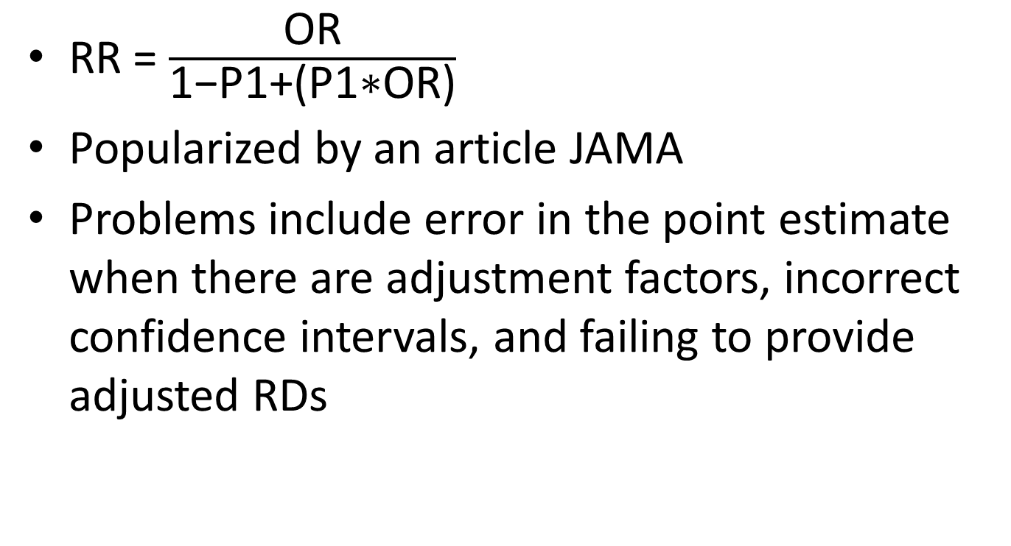
Formula for Converting OR to RR
RR = $\frac{\text{OR}}{\text{1−}\text{P}\text{1+(}\text{P}\text{1∗}\text{OR}\text{)}}$
Popularized by an article JAMA
Problems include error in the point estimate when there are adjustment factors, incorrect confidence intervals, and failing to provide adjusted RDs
Zhang J, Yu KF. What's the relative risk? A method of correcting the odds ratio in cohort studies of common outcomes. JAMA. 1998 Nov 18;280(19):1690-1.

Slide 70
Complex Survey Example
2007 National Survey of Children’s Health
  Design: Children sampled within State-level strata, weights to account for unequal probability of selection, non-response, and population totals
  Outcome: Breastfed to 6 months among subpopulation of children <=5
  Covariates: poverty (multiply imputed), race/ethnicity
Direct models, logistic margins
Interpretation of OR, RR, and RD

Slide 71
Common Outcome
PROC CROSSTAB data = example design=wr;
nest State idnumr;
supopn ageyr_child<=5;
WEIGHT NSCHWT;
class breastfed duration_6;
TABLE breastfed duration_6;
PRINT nsum wsum rowper serow lowrow uprow /style=nchs nsumfmt=f10.0 wsumfmt=f10.0;
Run;
Variance Estimation Method: Taylor Series (WR)
For Subpopulation: AGEYR_CHILD <= 5
by: Breastfed for 6 months.
------------------------------------------------------------------------------------------
Breastfed for 6 Lower Upper
months 95% 95%
Sample Weighted Row SE Row Limit Limit
Size Size Percent Percent ROWPER ROWPER
------------------------------------------------------------------------------------------
Total 27220 24214363 100.00 0.00 . .
0 14413 13191798 54.48 0.77 52.97 55.98
1 12807 11022565 45.52 0.77 44.02 47.03
------------------------------------------------------------------------------------------
Prevalence of 45.5%, we will see inflated ORs

Slide 72
Linear Probability Model (OLS)
PROC REGRESS DATA=mimp1 design=wr mi_count=5;
nest State idnumr;
subpopn ageyr_child<=5;
WEIGHT NSCHWT;
subgroup povl hisprace;
levels 4 5;
reflevel povl=1 hisprace=2;
rformat povl povl. ;
rformat hisprace hisprace.;
model duration_6 = povl hisprace;
run;
Variance Estimation Method: Taylor Series (WR) Using Multiply Imputed Data
SE Method: Robust (Binder, 1983)
Response variable DURATION_6: Breastfed for 6 months
-------------------------------------------------------------------------------------
Independent
Variables and Beta Lower 95% Upper 95%
Effects Coeff. SE Beta Limit Beta Limit Beta T-Test B=0
-------------------------------------------------------------------------------------
Intercept 0.36 0.02 0.32 0.41 16.46
HH Federal Poverty
Level
< 100% 0.00 0.00 . . .
100-199% 0.04 0.03 -0.02 0.09 1.23
200-399% 0.10 0.02 0.05 0.15 4.01
400+% 0.17 0.03 0.12 0.23 6.85
Race/Ethnicity
Hispanic 0.09 0.02 0.04 0.13 3.60
NH white 0.00 0.00 . . .
NH black -0.12 0.02 -0.17 -0.08 -5.78
NH multi -0.01 0.04 -0.08 0.06 -0.27
nh other 0.06 0.04 -0.02 0.14 1.39
-------------------------------------------------------------------------------------

Slide 73
STATA: Linear Probability Model
mi estimate: svy, subpop(subpop): regress duration_6 i.poverty ib2.hisprace
          Multiple-imputation estimates Imputations = 5
          Survey: Linear regression Number of obs = 90864
          Number of strata = 51 Population size = 73009309
          Number of PSUs = 90864 Subpop. no. of obs = 26788
          Subpop. size = 23731060
          Average RVI = 0.0342
          Complete DF = 90813
          DF adjustment: Small sample DF: min = 147.93
          avg = 30674.29
          max = 90789.37
          Model F test: Equal FMI F( 7,12859.2) = 20.46
          Within VCE type: Linearized Prob > F = 0.0000
          ---------------------------------------------------------------------------
        duration_6 | Coef. Std. Err. t P>|t| [95% Conf. Interval]
          -------------+----------------------------------------------------------------
          poverty |
          2 | .0354343 .0286946 1.23 0.219 -.0212699 .0921385
          3 | .0999863 .0249148 4.01 0.000 .0509184 .1490542
          4 | .1748259 .0255037 6.85 0.000 .1245973 .2250545
          hisprace |
          1 | .0858021 .0238642 3.60 0.000 .0390274 .1325768
          3 | -.1238822 .021422 -5.78 0.000 -.1658702 -.0818941
          4 | -.010175 .0378072 -0.27 0.788 -.0842768 .0639267
          5 | .0583567 .0418592 1.39 0.163 -.023687 .1404004
          |
          _cons | .3640481 .0221156 16.46 0.000 .3204612 .407635
------------------------------------------------------------------------------

Slide 74
Constant RD regardless of covariate pattern
Adjusting for race/ethnicity, children at 200-299%FPL have a 10% point increased probability of having been breastfed and children at 400%+FPL have a 17% point increased probability of having been breastfed to 6 months compared to those <100%FPL
Adjusting for income, Hispanic children have 9% point increased probability of having been breastfed and non-Hispanic Black children have 12% point decreased probability of having been breastfed to 6 months compared to non-Hispanic White children
Could calculate RR by hand
  For income 400%+FPL v. <100%FPL among White children is (0.36+0.17)/.36= 1.47
  OR is (0.53/0.47)/(0.36/.64) = 2.00

Slide 75
Generalized Linear Model (GLM)
Poisson with log link may be only SUDAAN option, so RRs only
PROC LOGLINK DATA=mimp1 design=wr mi_count=5;
nest State idnumr;
subpopn ageyr_child<=5;
WEIGHT NSCHWT;
subgroup povl hisprace;
levels 4 5;
reflevel povl=1 hisprace=2;
rformat povl povl. ;
rformat hisprace hisprace.;
model duration_6 = povl hisprace;
run;
-----------------------------------------------------------
Independent Incidence
Variables and Density Lower 95% Upper 95%
Effects Ratio Limit IDR Limit IDR
-----------------------------------------------------------
Intercept 0.37 0.33 0.41
HH Federal Poverty
Level
< 100% 1.00 . .
100-199% 1.09 0.95 1.27
200-399% 1.27 1.12 1.44
400+% 1.47 1.30 1.66
Race/Ethnicity
Hispanic 1.21 1.10 1.32
NH white 1.00 . .
NH black 0.70 0.62 0.80
NH multi 0.98 0.82 1.16
nh other 1.12 0.96 1.31
-----------------------------------------------------------

Slide 76
STATA: Generalized Linear Model
mi estimate: svy, subpop(subpop): glm duration_6 i.poverty ib2.hisprace, family(bin) link(identity)
        Multiple-imputation estimates Imputations = 5
        Survey: Generalized linear models Number of obs = 90864
        Number of strata = 51 Population size = 73009309
        Number of PSUs = 90864 Subpop. no. of obs = 26788
        Subpop. size = 23731060
        Average RVI = 0.0313
        Complete DF = 90813
        DF adjustment: Small sample DF: min = 174.44
        avg = 30624.64
        Within VCE type: Linearized max = 90774.11
        ------------------------------------------------------------------------------
      duration_6 | Coef. Std. Err. t P>|t| [95% Conf. Interval]
        -------------+----------------------------------------------------------------
        poverty |
        2 | .039623 .0285009 1.39 0.166 -.0166279 .095874
        3 | .1040618 .0249389 4.17 0.000 .0549794 .1531442
        4 | .1785439 .025624 6.97 0.000 .1281082 .2289796
        |
        hisprace |
        1 | .0871815 .0233608 3.73 0.000 .0413935 .1329695
        3 | -.1239448 .0219686 -5.64 0.000 -.1670041 -.0808855
        4 | -.0126999 .0395729 -0.32 0.748 -.0902624 .0648626
        5 | .0594402 .0402318 1.48 0.140 -.0194138 .1382942
        |
        _cons | .359714 .0225244 15.97 0.000 .3153627 .4040654
        ------------------------------------------------------------------------------

Slide 77
STATA: Generalized Linear Model
mi estimate, saving (miest): svy, subpop(subpop): glm duration_6 i.poverty ib2.hisprace, family(bin) link(log)
mi estimate (rr: exp(_b[4.poverty])) using miest
        ------------------------------------------------------------------------------
      duration_6 | Coef. Std. Err. t P>|t| [95% Conf. Interval]
        -------------+----------------------------------------------------------------
        poverty |
        2 | .0702296 .0763259 0.92 0.359 -.0808021 .2212613
        3 | .2052268 .0639967 3.21 0.002 .0790804 .3313733
        4 | .3509268 .0632075 5.55 0.000 .2263436 .47551
        |
        hisprace |
        1 | .1537167 .0446504 3.44 0.001 .0662004 .2412331
        3 | -.357499 .0672447 -5.32 0.000 -.4892994 -.2256985
        4 | -.0079284 .0871558 -0.09 0.928 -.178753 .1628962
        5 | .0933038 .0762942 1.22 0.221 -.0562321 .2428397
        |
        _cons | -.972535 .057875 -16.80 0.000 -1.086669 -.8584009
        ------------------------------------------------------------------------------
        Transformations
        rr: exp(_b[4.poverty])
        ------------------------------------------------------------------------------
        duration_6 | Coef. Std. Err. t P>|t| [95% Conf. Interval]
        -------------+----------------------------------------------------------------
        rr | 1.42064 .0898241 15.82 0.000 1.243599 1.597682
        ------------------------------------------------------------------------------

Slide 78
Logistic Model
PROC RLOGIST DATA=mimp1 design=wr mi_count=5;
nest State idnumr;
subpopn ageyr_child<=5;
WEIGHT NSCHWT;
subgroup povl hisprace;
levels 4 5;
reflevel povl=1 hisprace=2;
rformat povl povl. ;
rformat hisprace hisprace.;
model duration_6 = povl hisprace ;
predmarg povl(1)/adjrr;
predmarg hisprace(2)/adjrr;
pred_eff povl=(-1 1 0 0)/name="RD: 100-199%FPL v. <100% FPL";
pred_eff povl=(-1 0 1 0)/name="RD: 200-399%FPL v. <100% FPL";
pred_eff povl=(-1 0 0 1)/name="RD: 400%+ FPL v. <100% FPL";
pred_eff hisprace=(0 -1 1 0 0)/name="RD: NH Black v. NH White";
pred_eff hisprace=(1 -1 0 0 0)/name="RD: Hispanic v. NH White";
run;

Slide 79
OR versus RR: Poverty
-----------------------------------------------------------
Independent
Variables and Lower 95% Upper 95%
Effects Odds Ratio Limit OR Limit OR
-----------------------------------------------------------
HH Federal Poverty
Level
< 100% 1.00 . .
100-199% 1.17 0.91 1.49
200-399% 1.52 1.24 1.88
400+% 2.06 1.66 2.56
-------------------------------------------------------------------------
Predicted Marginal PREDMARG Lower Upper
Risk Ratio #1 Risk 95% 95%
Ratio SE Limit Limit
-------------------------------------------------------------------------
HH Federal Poverty
Level
100-199% vs. <100% 1.10 0.28 0.67 1.80
200-399% vs. <100% 1.27 0.28 0.83 1.95
400+% vs. < 100% 1.47 0.29 1.00 2.18
-------------------------------------------------------------------------
Excess risk estimate is doubled for OR versus RR
(~100% v. 50% for 400%+ Poverty)

Slide 80
OR versus RR: Race/Ethnicity
-----------------------------------------------------------
Independent
Variables and Lower 95% Upper 95%
Effects Odds Ratio Limit OR Limit OR
-----------------------------------------------------------
Race/Ethnicity
Hispanic 1.43 1.18 1.73
NH white 1.00 . .
NH black 0.58 0.48 0.70
NH multi 0.96 0.71 1.30
nh other 1.27 0.91 1.78
-----------------------------------------------------------
-------------------------------------------------------------------------
Predicted Marginal PREDMARG Lower Upper
Risk Ratio #2 Risk 95% 95%
Ratio SE Limit Limit
-------------------------------------------------------------------------
Race/Ethnicity
Hispanic 1.19 0.23 0.81 1.75
White 1.00
NH black 0.72 0.22 0.40 1.29
NH multi 0.98 0.29 0.55 1.75
nh other 1.13 0.31 0.66 1.92
-------------------------------------------------------------------------

Slide 81
Incorrect CIs for the RRs is due to programming glitch when using multiply imputed data
This will be corrected in SUDAAN 11 due out in 2012 but you could use a single imputation for now; absolute risk differences are not affected
----------------------------------------------------------------------------------------
Predicted Marginal PREDMARG Lower Upper
Risk Ratio #1 Risk 95% 95%
Ratio SE Limit Limit
----------------------------------------------------------------------------------------
HH Federal Poverty
Level
100-199% vs. < 100% 1.08 0.07 0.95 1.24
200-399% vs. < 100% 1.28 0.07 1.14 1.43
400+% vs. < 100% 1.46 0.08 1.31 1.64
----------------------------------------------------------------------------------------
----------------------------------------------------------------------------------------
Predicted Marginal PREDMARG Lower Upper
Risk Ratio #2 Risk 95% 95%
Ratio SE Limit Limit
----------------------------------------------------------------------------------------
Race/Ethnicity
Hispanic vs. NH white 1.20 0.05 1.09 1.31
NH black vs. NH white 0.72 0.05 0.63 0.82
NH multi vs. NH white 0.98 0.08 0.83 1.16
nh other vs. NH white 1.13 0.09 0.96 1.33
--------------------------------------------------------------------------------------- -

Slide 82
Risk Difference: Poverty
----------------------------------------------------------------------
Predicted Marginal Predicted
#1 Marginal SE T:Marg=0 P-value
----------------------------------------------------------------------
HH Federal Poverty
Level
< 100% 0.37 0.02 18.34 0.0000
100-199% 0.41 0.02 22.40 0.0000
200-399% 0.47 0.01 34.60 0.0000
400+% 0.54 0.01 38.42 0.0000
----------------------------------------------------------------------
----------------------------------------------------------------------
Contrasted Predicted PREDMARG
Marginal #1 Contrast SE T-Stat P-value
----------------------------------------------------------------------
RD: 100-199%FPL v.
<100% FPL 0.04 0.03 1.25 0.2129
RD: 200-399%FPL v.
<100% FPL 0.10 0.02 4.03 0.0001
RD: 400%+ FPL v.
<100% FPL 0.17 0.03 6.86 0.0000

Slide 83
Risk Difference: Race/Ethnicity
----------------------------------------------------------------------
Predicted Marginal Predicted
#2 Marginal SE T:Marg=0 P-value
----------------------------------------------------------------------
Race/Ethnicity
Hispanic 0.54 0.02 24.76 0.0000
NH white 0.45 0.01 50.77 0.0000
NH black 0.32 0.02 16.25 0.0000
NH multi 0.44 0.04 11.95 0.0000
nh other 0.51 0.04 12.28 0.0000
----------------------------------------------------------------------
----------------------------------------------------------------------
Contrasted Predicted PREDMARG
Marginal #5 Contrast SE T-Stat P-value
----------------------------------------------------------------------
RD: Hispanic v. NH
White 0.09 0.02 3.65 0.0003
RD: NH Black v. NH
White -0.13 0.02 -5.79 0.0000
----------------------------------------------------------------------

Slide 84
Advantage of Absolute Scale
Can calculate actual numbers affected
Weighted N for children <100% FPL is 5.1 million
  If children <100%FPL had same probability of being breastfed to 6 months as children 400%+, 0.17*5.1 = 0.9 million more children would have been breastfed to 6 months

Slide 85
STATA: Logistic Model
Margins command can’t be used with multiple imputation so select a single imputation
mi extract 1
svy, subpop(subpop): logistic duration_6 i.poverty ib2.hisprace
      Survey: Logistic regression
      Number of strata = 51 Number of obs = 90864
      Number of PSUs = 90864 Population size = 73009309
      Subpop. no. of obs = 26788
      Subpop. size = 23731060
      Design df = 90813
      F( 7, 90807) = 18.12
      Prob > F = 0.0000
      ------------------------------------------------------------------------------
      | Linearized
    duration_6 | Odds Ratio Std. Err. t P>|t| [95% Conf. Interval]
      -------------+----------------------------------------------------------------
      poverty |
      2 | 1.140691 .1285676 1.17 0.243 .914592 1.422684
      3 | 1.536017 .1523077 4.33 0.000 1.264713 1.865522
      4 | 2.038324 .2077057 6.99 0.000 1.669301 2.488927
      |
      hisprace |
      1 | 1.434233 .1391865 3.72 0.000 1.185804 1.734708
      3 | .5779241 .0574358 -5.52 0.000 .4756361 .7022096
      4 | .962499 .1503845 -0.24 0.807 .7086039 1.307366
      5 | 1.269429 .2180257 1.39 0.165 .906592 1.777482
      ------------------------------------------------------------------------------

Slide 86
STATA Logistic: Relative Risk
- Use margins with the subpop since analyzing a subset of total sample (age<=5)
- Use vce(unconditional) to adjust SEs for survey design
svy, subpop(subpop): logistic duration_6 i.poverty ib2.hisprace
margins poverty, subpop(subpop) vce(unconditional) post
      Predictive margins Number of obs = 90864
      Subpop. no. of obs = 26788
      Expression : Pr(duration_6), predict()
      ------------------------------------------------------------------------------
      | Linearized
      | Margin Std. Err. t P>|t| [95% Conf. Interval]
      -------------+----------------------------------------------------------------
      poverty |
      1 | .3715442 .0188056 19.76 0.000 .3346855 .4084029
      2 | .4022819 .01741 23.11 0.000 .3681585 .4364054
      3 | .4742277 .0131662 36.02 0.000 .448422 .5000334
      4 | .5436441 .0141145 38.52 0.000 .5159799 .5713082
      ------------------------------------------------------------------------------
      . nlcom _b[4.poverty] / _b[1.poverty]
      _nl_1: _b[4.poverty] / _b[1.poverty]
      ------------------------------------------------------------------------------
      | Coef. Std. Err. t P>|t| [95% Conf. Interval]
      -------------+----------------------------------------------------------------
      _nl_1 | 1.463202 .0844512 17.33 0.000 1.297678 1.628725
      ------------------------------------------------------------------------------

Slide 87
STATA Logistic: Risk Difference
svy, subpop(subpop): logistic duration_6 i.poverty ib2.hisprace
margins, subpop(subpop) dydx(*) vce(unconditional)
    Average marginal effects Number of obs = 90864
    Subpop. no. of obs = 26788
    Expression : Pr(duration_6), predict()
    dy/dx w.r.t. : 2.poverty 3.poverty 4.poverty 1.hisprace 3.hisprace 4.hisprace 5.hisprace
    ------------------------------------------------------------------------------
    | Linearized
    | dy/dx Std. Err. t P>|t| [95% Conf. Interval]
    -------------+----------------------------------------------------------------
    poverty |
    2 | .0307377 .0262696 1.17 0.242 -.0207504 .0822258
    3 | .1026835 .0232695 4.41 0.000 .0570756 .1482914
    4 | .1720999 .0239191 7.20 0.000 .1252187 .218981
    |
    hisprace |
    1 | .0882572 .0235793 3.74 0.000 .0420419 .1344724
    3 | -.1267507 .0218456 -5.80 0.000 -.1695679 -.0839335
    4 | -.0092649 .037804 -0.25 0.806 -.0833604 .0648305
    5 | .0583686 .0421401 1.39 0.166 -.0242256 .1409629
    ------------------------------------------------------------------------------

Slide 88
Literature Examples

Slide 89
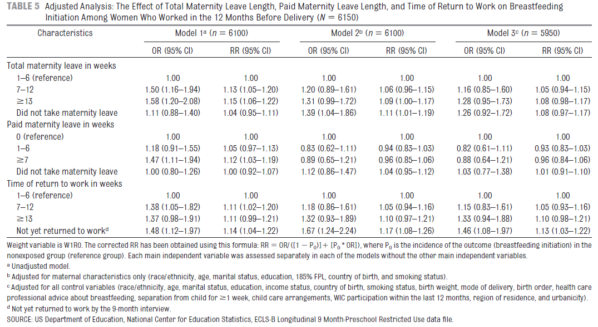
Maternity Leave & Breastfeeding
Ogbuanu C, Glover S, Probst J, Liu J, Hussey J. The effect of maternity leave length and time of return to work on breastfeeding. Pediatrics. 2011 Jun;127(6):e1414-27.

Slide 90
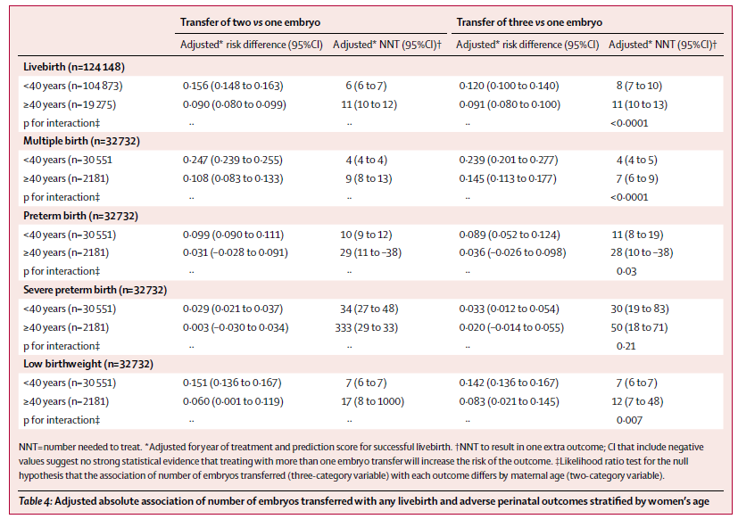
IVF and Maternal Age
Lawlor DA, Nelson SM. Effect of age on decisions about the numbers of embryos to transfer in assisted conception: a prospective study. Lancet. 2012 Feb 11;379(9815):521-7.

Slide 91
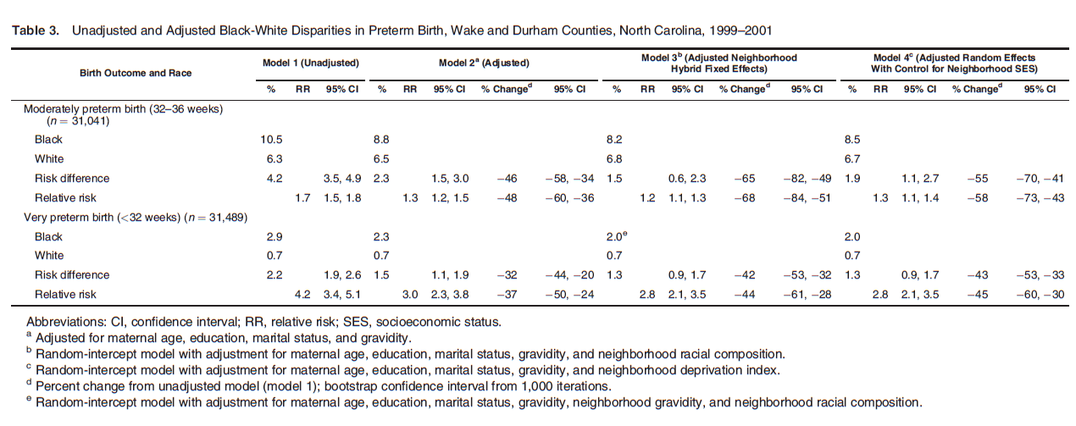
Perinatal Disparities
Schempf AH, Kaufman JS, Messer LC, Mendola P. The neighborhood contribution to black-white perinatal disparities: an example from two north Carolina counties, 1999-2001. Am J Epidemiol. 2011 Sep 15;174(6):744-52.

