Slide 1

An Introduction to
Evaluation Methods
Embry Howell, Ph.D.
The Urban Institute
Notes:
Thanks for inviting me…
My brief bio and how I came to evaluation in my career…

Slide 2

Introduction and Overview
Why do we do evaluations?
What are the key steps to a successful program evaluation?
What are the pitfalls to avoid?
Notes:
Here is what I hope to accomplish this afternoon:
Spend about an hour or so getting everyone on the same page with basic eval concepts and terminology
Stretch, and then spend another hour or so discussing in depth impact evaluation methods
After a break we will spend some time talking about your own evaluation issues. Several of you sent excellent examples of your evaluation challenges and we will go through those one-by-one as examples.
Please raise your hand if you have questions and we will try to take some of those as they come up along the way.
First I want to remind you of the four articles you were sent that are examples of the types of program evaluations you might conduct. From time to time I will bring up these articles as examples. They are:
The first is a study by Greg Stevens et al. of Healthy Kids /California of the quality of the medical home for children in three groups: uninsured, recently insured, and insured for one year or more. Close to my heart…
The second is a study by Salihu et al of a Healthy Start’s program in FLA on the rate of primary and repeat teen pregnancy
The third is a study by Olson, et al. in the Maternal and Child Health Journal of a study of peer counseling breast feeding support in a WIC program in Michigan.
The final one is a study in Arizona by Lightwood and Glantz of the relationship between tobacco control expenditures, cigarette consumption , and medical care costs.
The first three would be considered impact analyses and the fourth a cost-effectiveness analysis, terms that will become clearer as we proceed.
I also refer occasionally to my own recent article with Jenny Kenney which you also received that synthesized evidence on the impact of the Medicaid/CHIP expansions for children.

Slide 3
Why Do Evaluation?
Accountability to program funders and other stakeholders
Learning for program improvement
Policy development/decision making: what works and why?
Notes:
Put the money in the right place
Identify and encourage high performers and help poor performers improve
Two types of program evaluation: ongoing/existing programs and new/special demos

Slide 4
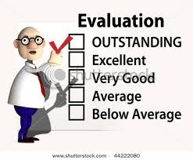
“Evaluation is an essential part of public health; without evaluation’s close ties to program implementation, we are left with the unsatisfactory circumstance of either wasting resources on ineffective programs or, perhaps worse, continuing public health practices that do more harm than good.”
Quote from Roger Vaughan, American Journal of Public Health, March 2004.
Notes:
Read quote
Stress that evaluation currently is getting more emphasis throughout government
Pause: any questions or comments before we get started?
As an exercise, please take a moment to take out your handout: write name and brief description of a program that you are familiar with and/or that your agency oversees that would benefit from evaluation
Describe exercise

Slide 5

Key Steps to Conducting a Program Evaluation
Stakeholder engagement
Design
Implementation
Dissemination
Program change/improvement
Notes:
A successful evaluation can be divided into several key steps each of which must be conducted with careful planning
Often one or more of these steps is ignored, resulting in the evaluation “being put on the shelf”
These are: read slide…..

Slide 6

Stakeholder Engagement
Program staff
Government
Other funders
Beneficiaries/advocates
Providers
Notes:
Important for getting funding, developing support and buy-in from program and advocates, setting stage for “utilization-focused evaluation”: program change!
List provides examples of most important stakeholders for most evaluations
Each of these key players must recognize why evaluation is needed and provide input/support
Discuss each in turn

Slide 7
Develop Support and Buy-in
Identify key stakeholders
Solicit participation/input
Keep stakeholders informed
“Understand, respect, and take into account differences among stakeholders…” AEA Guiding Principles for Evaluators.
Notes:
Stakeholders: respondents, program participants, funders, etc.
Cultural/community sensitivity is key.

Slide 8
Evaluability Assessment
Develop a logic model
Develop evaluation questions
Identify design
Assess feasibility of design: cost/timing/etc.
Notes:
Evaluability assessment is the process of determining which type of evaluation is feasible and useful
Important to have this stage in each evaluation, large and small

Slide 9
Develop a Logic Model
Why use a logic model?
What is a logic model?
Notes:
Logic models provide a visual map of program and its goals
Stimulate clear thinking about what is to be accomplished in program and its evaluation
Help formulate research questions
Keep it simple; only as much detail as is needed for evaluation planning
Inputs and activities/outputs/outcomes
Indicators

Slide 10
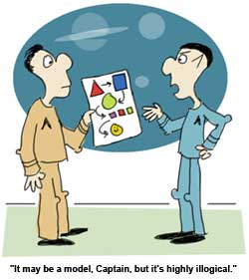
Notes:
Read heading

Slide 11
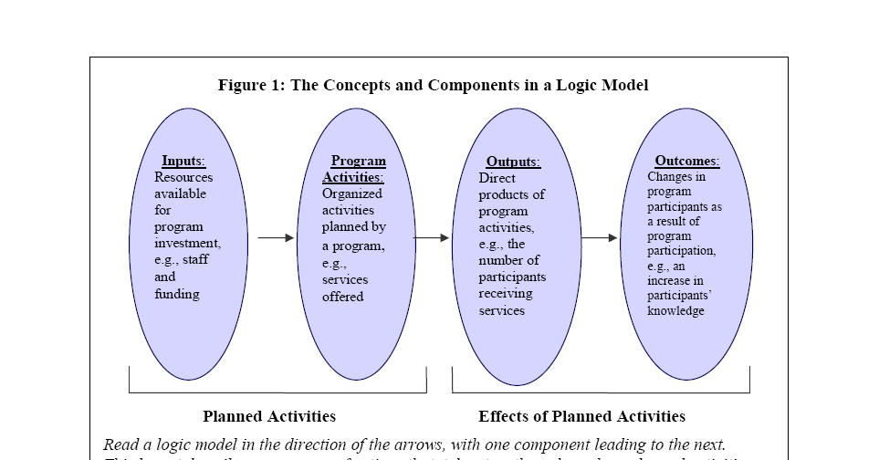
Notes:
This generic logic model comes from a publication from Child Trends called “Logic Models for Out-of-School Time Programs”
Flow is left to right
Boxes have things that can be measured in the evaluation
To the left you have program inputs such as staff and funding; often a model will also have external (eg. community/population) characteristics outside the program’s purview
Next you have program activities; things that could be measured such as activities
Next ‘outputs” sometimes called interim outcoms
Finally you have the ultimate program outcomes; accomplishments that demonstrate program success

Slide 12
Example of Specific Logic Model for After School Program
Notes:
This comes from an Urban Institute Publication which has a similar flow, but elaborates the specific things to be measured in the evaluation.
To the left you have the target population characteristics, resources, and “antecedent variables” such as neighborhood and family; all of these fall into the category that the previous slide called “inputs”
Next you have the program description such as case management and after school programs, with “mediating variables” shown, too, such as level of participation in similar programs (not the program being evaluated)
Next, intermediate outcomes, such as reduction in risk factors
Finally, you have outcomes such as drug use and teen pregnancy rates
PAUSE: now draw a quick sketch of your program to be evaluated with at least the four major boxes, flowing left to right

Slide 13

Develop Evaluation Questions
Questions that can be answered depend on the stage of program development and resources/time.
Notes:
Often programs and evaluators launch into the evaluation without thinking clearly about the questions they want to answer
Often the questions are more ambitious than necessary or appropriate for the stage of program implementation
Example from one of the articles you read on the effect of peer counseling on breast feeding: “What is the effect of peer counseling on the rate of breast feeding?” (Answering this requires one type of evaluation--impact analysis.) An alternative question could have been: “Did breast feeding increase among program participants?” (does not require impact analysis)

Slide 14

Assessing Alternative
Designs
Case study/implementation analysis
Outcome monitoring
Impact analysis
Cost-effectiveness analysis
Notes:
These come from my article in the American Journal of Evaluation describing four types of evaluation designs, each answering different types of questions
Flow is from easy to hard; less costly to most costly; quicker to slower; each builds on the other and are not mutually exclusive; mixed methods are best.

Slide 15
Early State of Program or New Initiative within a Program Type of Evaluation __________
-Is the program being delivered as intended? 1. Implementation
-What are successes/challenges with implementation? Analysis/ Case Study
-What are lessons for other programs?
-What unique features of environment lead to success?
Mature, stable program with well-defined program model________________________________
-Are desired program outcomes obtained? 2. Outcome monitoring
-Do outcomes differ across program approaches or subgroups?
-Did the program cause the desired impact? 3. Impact Analysis
-Is the program cost-effective (worth the money)? 4. Cost –effectiveness analysis
Notes:
This shows that in the early stages of a program, implementation anaysis/case studies may be the most appropriate for quick feedback
Once program is established, an ongoing monitoring of outcomes is appropriate (to answer questions like did rate of breastfeeding go up over time)
Next stage (or at same time with comparison group): impact analysis
Finally (rarely done) cost-effectiveness: worth the money?
PAUSE: List up to five questions you would like to answer with your program evaluation on the worksheet
Took much of this from GAO report on Designing Evaluations 2012

Slide 16

Confusing Terminology
Process analysis=implementation analysis
Program monitoring=outcome monitoring
Cost-effectiveness=Cost-benefit (when effects can be monitized)= Return-on-Investment (ROI)
Formative evaluation: similar to case studies/implementation analysis; used to improve program
Summative evaluation: uses both implementation and impact analysis (mixed methods)
“Qualitative”: a type of data often associated with case studies
“Quantitative”: numbers; can be part of all types of evaluations, most often outcome monitoring, impact analysis, and cost-effectiveness analysis
“Outcome measure”=“impact measure”(in impact analysis)
Notes:
Is an evaluation only an impact analysis with a control or comparison group? Some say yes and some say no.
Go over terminology in slide

Slide 17
Case Studies/Implementation
Analysis
Quickest and lowest-cost type of evaluation
Provides timely information for program improvement
Describes community context
Assesses generalizability to other sites
May be first step in design process, informing impact analysis design
In-depth ethnography takes longer; used to study beliefs and behaviors when other methods fail (e.g. STDs, contraceptive use, street gang behavior)
Notes:
More detail on Case Studies/Implementation analysis
Often first stage of a multi-facited evaluation

Slide 18
Outcome Monitoring
Easier and less costly than impact evaluation
Uses existing program data
Provides timely ongoing information
Does NOT answer well the “did it work” question
Notes:
Can use administrative records
Usually involves a new automated data system
“Dash boards”
GIPRA
Very important form of evaluation but not the same as impact evaluation, since other factors may cause changes
If program is very intensive and data system is very good maybe yield credible results on program success

Slide 19
Impact Analysis
Answers the key question for many stakeholders: did the program work?
Hard to do; requires good comparison group
Provides basis for cost-effectiveness analysis
Notes:
This is often what people think of as “evaluation” and is often what stakeholders want, but is very hard to do well
You read several articles that used impact analysis, including those studying the impact of peer counseling on breastfeeding, the impact of a Healthy Start program on teen pregnancy, the impact of health insurance for kids on the quality of the medical home, and the impact of smoking cessation; all had different approaches to finding a comparison group.
Will talk more about this type of evaluation in second part of the afternoon

Slide 20

Cost-Effectiveness Analysis/
Cost-Benefit Analysis
Major challenges:
Measuring cost of intervention
Measuring effects (impacts)
Valuing benefits
Determining time frame for costs and benefits/impacts
Notes:
Cost of all resources that it uses had they been assigned to their most valuable alternative use
Must specify which costs (direct, societal), and all the “ingredients”
This design answers the bottom-line questions that most policy makers have, but is controversial and difficult to implement and rarely done in health
Good example of an attempt at this is the article you read on the impact of tobacco control programs in AZ
Need to calculate “present value” of benefits and costs.

Slide 21

An Argument for Mixed Methods
Truly assessing impact requires implementation analysis:
  Did program reach population?
  How intensive was program?
  Does the impact result make sense?
  How generalizable is the impact? Would the program work elsewhere?
Notes:
An impact analysis can say whether outcomes changed because of the program, but not why or how they changed.
For example, the WIC peer counseling study that you read did not have an intensive case study that would allow for a clear understanding of the “dosage”/intensity of the intervention.
PAUSE: Now after learning a bit about the four types of evaluations, list which of the four components you would need to use to answer the evaluation questions you listed on your worksheet. Think a bit about the components of the evaluation and how you would do it. If you want to do impact evaluation, what would the comparison group be?

Slide 22


Assessing Feasibility/Constraints
How much money/resources are needed for the evaluation: are funds available?
Who will do the evaluation? Do they have time? Are skills adequate?
Need for objectivity?
Notes:
Very critical part of evaluability assessment

Slide 23

Assessing Feasibility, contd.
Is contracting for the evaluation desirable?
How much time is needed for evaluation? Will results be timely enough for stakeholders?
Would an alternative, less expensive or more timely, design answer all/most questions?
Notes:
Once these questions are answered (read them and discuss), will probably need to revisit questions and design

Slide 24
Particularly Challenging
Programs to Evaluate
Programs serving hard-to-reach groups
Programs without a well-defined or with an evolving intervention
Multi-site programs with different models in different sites
Small programs
Controversial programs
Programs where impact is long-term
Notes:
Discuss each type and why it’s hard
Most public health programs have one or more of these characteristics!

Slide 25

Developing a Budget
  Be realistic!
  Evaluation staff
  Data collection and processing costs
  Burden on program staff
Notes:
Try to factor in all costs large and small
Be realistic about what program staff can/should do
Easy to underestimate true costs

Slide 26
Revising Design as Needed
After realistic budget is developed, reassess the feasibility and design options as needed.
Notes:
Do you want to rethink the type of evaluation you want to attempt now? (your worksheet)

Slide 27

“An expensive study poorly designed and executed is, in the end, worth less than one that costs less but addresses a significant question, is tightly reasoned, and is carefully executed.”
Designing Evaluations, Government Accountability Office, 1991
Notes:
The most expensive design may not be the best
Refer to my article and the expense of large federal evaluations and the problems they encountered

Slide 28
Developing an Evaluation Plan
Time line
Resource allocation
May lead to RFP and bid solicitation, if contracted
Revise periodically as needed
Notes:
Important first step: time line/milestones
Important for tracking whether the evaluation is on time and budget as planned

Slide 29
Developing Audience and Dissemination Plan
Important to plan products
for audience
Make sure dissemination is
part of budget
Include in evaluation contract, if appropriate
Allow time for dissemination!

Slide 30

Key steps to Implementing Evaluation Design
Define unit of analysis
Collect data
Analyze data

Slide 31


Key Decision: Unit of Analysis
Site
Provider
Beneficiary
Notes:
Drives from research questions: Did rate of breastfeeding go up? (requires beneficiary-level data). Did WIC providers implement peer counseling? Requires provider-level information.)
Drives data collection approach
Might study sites and providers with case study and beneficiaries with survey?

Slide 32
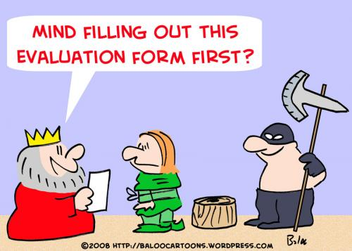
Collecting Data
Qualitative data
Administrative data
New automated data for tracking outcomes
Surveys (beneficiaries, providers, comparison groups)
Notes:
Look for the lowest cost alternative to answer the research questions; may need multiple data sources.

Slide 33

Human Subjects Protection
Need IRB Review?
Who does review?
Leave adequate time
Notes:
Different research/evaluation settings have different requirements, but it’s important to think through the issues regardless

Slide 34
Qualitative Data
Key informant interviews
Focus groups
Ethnographic studies
  E.g. street gangs, STDs, contraceptive use
Notes:
Resources drive number of interviews/focus groups
Ethnographic studies are hard to do
Need protocols

Slide 35

Administrative Data
Claims/encounter data
Vital statistics
Welfare/WIC/other nutrition data
Hospital discharge data
Linked data files
Notes:
Good examples from the articles you read: WIC breastfeeding study used WIC administrative data; Healthy Start study used birth certificates; smoking study for AZ used existing state data.
Important to assess quality carefully

Slide 36

New Automated Tracking Data
Special program administrative tracking data for the evaluation
  Define variables
  Develop data collection forms
  Automate data
  Monitor data quality
  Revise process as necessary
  Keep it simple!!
Notes:
Fits well with program monitoring design
Data collection may be already underway or you may need a new data system
Leave plenty of time before data are “research ready”
Problem/bias: “loss to follow-up”; can’t track people who aren’t in the program (“drop-outs’)

Slide 37

Surveys
Beneficiaries
Providers
Comparison groups
Notes:
Most expensive form of data collection
Surveys are expensive. Make sure you have resources. Make sure there is not another lower cost way to collect the data.
Requires specialized expertise to do well
Some may be already underway: BRFSS and PRAMS

Slide 38
Key Survey Decisions
Mode:
  In-person (with our without computer assistance)
  Telephone
  Mail
  Internet
Response Rate Target
Sampling method (convenience, random)
Notes:
Mail and internet surveys have low response rates; in-person and telephone surveys may have response rates well over 50 percent; 50% is rough guideline for “scientific survey”
These decisions drive the budget.

Slide 39
Key Steps to Survey Design
Establish sample size/power calculations
Develop questionnaire to answer research questions (refer to logic model)
Recruit and train staff
Automate data
Monitor data quality
Notes:
Read through key steps and explain

Slide 40
Hours Duration
1. Goal clarification ________ ________
2. Overall study design ________ ________
3. Selecting the sample ________ ________
4. Designing the questionnaire
and cover letter ________ ________
5. Conduct pilot test ________ ________
6. Revise questionnaire (if necessary) ________ ________
7. Printing time ________ ________
8. Locating the sample (if necessary) ________ ________
9. Time in the mail & response time ________ ________
10. Attempts to get non-respondents ________ ________
11. Editing the data and
coding open-ended questions ________ ________
12. Data entry and verification ________ ________
13. Analyzing the data ________ ________
14. Preparing the report ________ ________
15. Printing & distribution of the report ________ ________
From: Survival Statistics, by David Walonick
Notes:
Example check list for developing the budget for designing and implementing a mail survey and data analysis, taken from Survival Statistics

Slide 41
Analyzing Data
Qualitative methods
  Protocols
  Notes
  Software
Descriptive and analytic methods
  Tables
  Regression
  Other
Notes:
Impact analysis without random assignment requires the most sophisticated analytic techniques to control for bias/design flaws, such as propensity score analysis, instrumental variable analysis (two stage regression), response rate adjustments, etc.

Slide 42

Dissemination
Reports
Briefs
Articles
Reaching out to audience
  Briefings
  Press
Notes:
Circle back to your key stakeholders as the target audience: how is the best way to reach them?
When you publish be sure to give adequate detail of why/when/how you did the study: subjects, data collection, analysis, caveats

Slide 43

Ethical Issues in Evaluation
Maintain objectivity/avoid conflicts of interest
Report all important findings: positive and negative
Involve and inform stakeholders
Maintain confidentiality and protect human subjects
Minimize respondent burden
Publish openly and acknowledge all participants
Notes:
Involvement of program staff in evaluation can compromise objectivity; must maintain balance
More important in “summative” than “formative” evaluation
See American Evaluation Association “Guiding Principles for Evaluators”
PAUSE now for a break before we discuss impact evaluation in more detail
Ask if they would like to hand in their worksheets so that I can go through a few of them during the break; put names on them if you want them back.

Slide 44
Impact Evaluation
Why do an impact evaluation?
When to do an impact evaluation?
Notes:
Some people (not me) think of impact evaluation as the ONLY kind of evaluation, and that other techniques should not be called “evaluation.” This is another semantic problem.

Slide 45
Developing the counter-factual:
“WITH VS. WITHOUT”
Random assignment: control group
Quasi-experimental: comparison group
Pre/post only
Other
Notes:
This is the critical and most difficult part of impact evaluation
Talk through some of the issues with each

Slide 46

Random Assignment Design
Definition: Measures a program’s impact by randomly assigning subjects to the program or to a control group
(“business as usual,” “alternative program,” or “no treatment”)
Notes:
Random assignment designs are rare in public health interventions/ common for pharmaceuticals
Concerns with ethics of denying services/treatment
Should be more widespread/can randomize when demand exceeds supply/ can use waiting lists

Slide 47
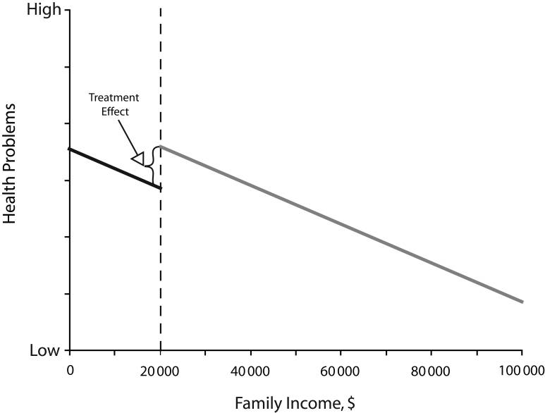
Example of Alternative to Random Assignment: Regression Discontinuity Design (See West, et al, AJPH, 2008)
Notes:
Other examples of designs that are being used increasingly as a substitute for random assignment, eg. regression discontinuity design
Comes from AJPH , West, et al, 2008, illustrating impact of school lunch program on health: “permits the inference of a treatment effect for the school lunch program if there is a discontinuity at the income threshold where the treatment is introduced.”
Has been used effectively for Medicare evaluations with age 65 as cut-off

Slide 48

Quasi-experimental Design
Compare program participants to well-matched non-program group:
  Match on pre-intervention measures of outcomes
  Match on demographic and other characteristics (can use propensity scores)
  Weak design: compare participants to non-participants!
  Choose comparison group prospectively, and don’t change!
Notes:
Examples from the articles you read: WIC study: people who volunteered who were not contacted (could be different in unmeasured ways from those contacted (more primiperas in study group); eg. no phone numbers, more mobile, less interested.
Heatlhy Kids, used waiting list, good comparison group as long as kids are taken off list randomly;

Slide 49

Examples of Comparison Groups
Similar individuals in same geographic area
Similar individuals in different geographic area
All individuals in one area (or school, provider, etc.) compared to all individuals in a well-matched area (or school, provider)
Notes:
Biggest challenge for quasi-experimental designs: need to find a well-matched comparison group
Using everyone in a target area as the study population avoids selection problems, but if intervention target group is small, it will underestimate effects.
Healthy Start study compared teens in target zip codes to all other teens in county, likely has problem that target neighborhoods are very different; better to match on neighborhood characteristics including teen birth rate before intervention.

Slide 50

Pre/Post Design
Can be strong design if combined with comparison group design
Otherwise, falls in category of outcome monitoring, not impact evaluation
Advantages: controls well for client characteristics
Better than no evaluation as long as context is documented and caveats are described
Notes:
Has similarity to outcome monitoring
When combined with quasi-experimental and there are data for both study and comparison groups, can be very strong design: “difference-in-differences”
See my article on impact of Medicaid/CHIP expansions: method used frequently

Slide 51
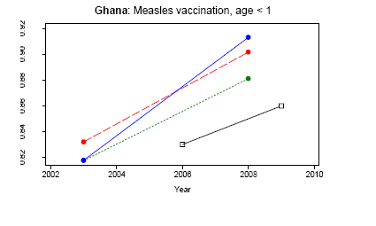
Misleading conclusions from pre/post comparisons:
“Millennium Village” evaluation
Notes:
Here is an example of how a purely pre-test/post-test design can be misleading
This is an example from the evaluation of the Millennium Villages in Africa, where intensive services are poured into selected communities. In this example from Ghana, the black line on the bottom of the chart shows an increasing rate of measles vaccination for children in the Millennium village. However if you look at the three other lines, which represent the overall increase in Ghana country-wide (red), the increase in that village’s rural region (blue), and rural areas overall in Ghana (green) you can see that the rate of increase is about the same, or greater. So it is hard to attribute the increase in measles vaccination to Millenium Villages. This is why comparison groups are so powerful. It is possible that the kids in the Millennium Village are particularly poor or disadvantaged, so a better comparison might be a matched group in another village or rural area. Might show better results.

Slide 52
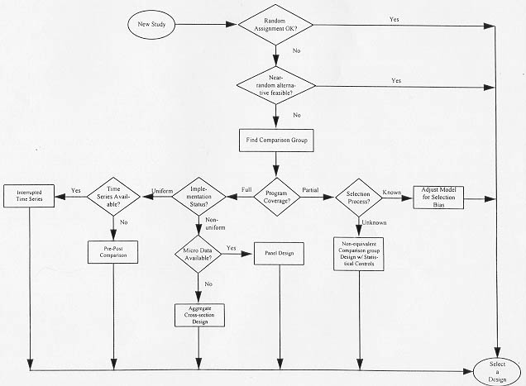
Steps to Developing a Comparison Group
Steps to Developing Design
Notes:
Flow chart illustrates a process for selecting the best feasible impact evaluation design
Can you do random assignment? If so, do
If not, find a comparison group (quasi-experimental)
Investigate the selection process into the program; adjust (statistically) for selection: instrumental variables, propensity scores, etc.
Analysis approach depends on data available
If studying the whole community/population, consider using time series/interrupted time series

Slide 53

How do different designs stack-up?
i. External validity
ii. Internal validity
iii. Sources of confounding
Notes:
Designs with multiple sites or larger sample diversity add to external validity
Designs with random assignment have highest internal validity, but often low external validity
Main sources of confounding are associated with quasi-experimental (comparison group) designs; depends on how well-matched the comparison group is.

Slide 54
Sources of Confounding
“Selection bias” into study group: e.g. comparing participants to non-participants
“Omitted variable bias”: lack of data on key factors affecting outcomes other than the program
Notes:
Many sources of confounding with quasi-experimental designs, which are the most common in impact evaluations of health programs
Usually study and comparison groups are not completely well-matched on all characteristics affecting outcomes.

Slide 55

Efficacy: can it work? (Did it work once?)
Effectiveness: does it work?
(Will it work elsewhere?)
Notes:
Answering first question well requires high internal validity; random assignment is best.
Answering second question requires high external validity; often random assignment studies are weak here.
Most people are more interested in effectiveness, but hard to get good estimates—very expensive.
Example from nurse partnership home visiting; has been hard/controversial to estimate generalizability.

Slide 56

Random Assignment:
Always the Gold Standard?
Pros:
  Measures impact without bias
  Easy to analyze and interpret results
Cons:
  High cost
  Hard to implement correctly
  Small samples
  Limited generalizability (external validity)
Notes:
External validity increased by selecting sites purposively

Slide 57

Example: Nurse Family Partnership Home Visiting
Clear positive impacts from randomized trials
Continued controversy concerning which places and populations where these impacts will occur
Carefully controlled nurse home visiting model leads to impacts, but unclear whether and when impacts occur when model is varied
(e.g. lay home visitors)
Notes:
In spite of these problems federal government is moving forward with expanded federally-funded home visiting
Important area for further evaluation of different models

Slide 58
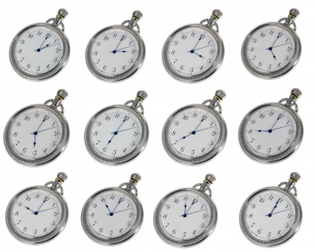
Timing
What is the study period?
How long must you track study and comparison groups?
Notes:
This goes back to the research questions.
Are the key outcomes/impacts long term or short term.
For example, knowledge and attitudes can be measured short term and may show positive outcomes
Behavior change takes longer to measure; outcomes may be weaker
EG. Federal abstinence evaluation, took several years and did not show behavior change

Slide 59

Number of sites?
More sites improves generalizability
More sites increases cost substantially
Clustering of data adds to analytic complexity
Notes:
Important for assessing generalizability/external validity
Requires statistical techniques to address clustering
The more sites the better, but very expensive

Slide 60
Statistical power: how many subjects?
On-line tools to do power
calculations
Requires an estimate of the
likely difference between study group and comparison group for key impact measures
Notes:
To do power calculations you need an estimate of the likely size of the effect (and variance)—rough guesses based on literature
Also need desired power, eg. 80 percent power to detect a significant difference between study and comparison group at 5% level.
Automated programs will then tell you the desired sample size for study and comparison group
Groups do not have to be same size; can get good power if your study group is larger and comparison group smaller
Very critical to cost of evaluation, especially when primary data collection is needed.
Sample size must be much larger if subgroup analysis is needed to answer research questions.

Slide 61

Attrition
Loss to follow-up: can be serious issue for longitudinal studies
Similar to response rate problem
Special problem if rate is different for study and control/comparison groups
Notes:
Can’t find the people for follow-up!!
Read dot points
Eg. Breastfeeding study in article you read: the match rate to outcome data for participants in program was 78% but for the comparison group it was 68%. Essentially same as attrition in that outcomes could not be measured at same rate.

Slide 62
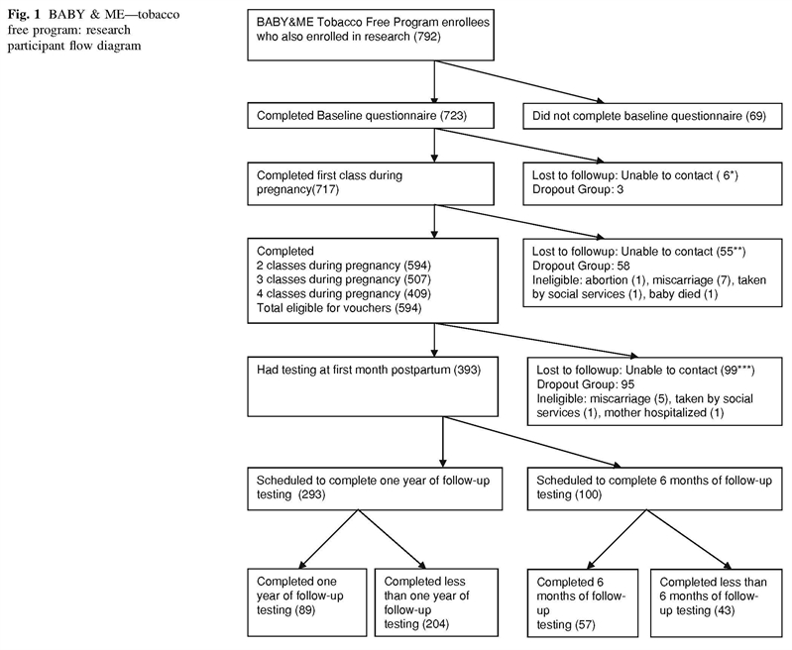
Notes:
This chart from the article from the Maternal and Child Health Journal article illustrates the bias from loss to follow-up and low response rates. Originally there were 1214 program participants but only 792 agreed to participate in the study.
Many other reasons happened that folks dropped out along the way. In the end only about a fourth of program participants could be studied. Unknown selection factors bias results.

Slide 63
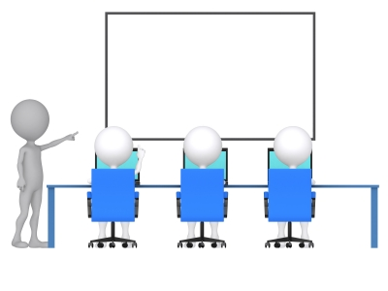
Cross-over and Contamination
Control or comparison group may be exposed to program or similar intervention
Can be addressed by comparing geographic areas or schools
Notes:
Cross-over: people leave the comparison group and join the study group or vice-versa
Contamination: People in the comparison groups are (sometimes indirectly) exposed to the intervention, eg. students in the same school or siblings

Slide 64

Cost/feasibility of
Alternative Designs
Larger samples: higher cost/greater statistical power
More sites: higher cost/greater generalizability
Random assignment: higher cost/less bias and more robust results
Longer time period: higher cost/better able to study longer term effects
Notes:
Revisiting the cost issues: in summary……
Unfortunately cost issues have a big influence over design decisions!

Slide 65

Major Pitfalls of
Impact Evaluations
Lack of attention to feasibility and community/program buy-in
Lack of attention to likely sample sizes and statistical power
Poor implementation of random assignment process
Poor choice of comparison groups (for quasi-experimental designs): e.g. non-participants
Non-response and attrition
Lack of qualitative data to understand impacts (or lack thereof)
Notes:
Going back to my study of major federal evaluations……

Slide 66
Use Sensitivity Analysis!
When comparison group is not ideal, test significance/size of effects with alternative comparison groups.
Make sure pattern of effects is similar for different outcomes.
Notes:
Use your instincts by pouring through data
Do not take things at face value
Lay out caveats in reports

Slide 67
Conclusions: Be Smart!
Know your audience
Know your questions
Know your data
Know your constraints
Go into an impact evaluation with your eyes open
Make a plan and follow it closely
Notes:
To wrap up:….
Now a break before we go to some examples from you….

Slide 68
Example One
Research Question: What is the prevalence of childhood obesity and how is it associated with demographic, school, and community characteristics?
Data are from an existing longitudinal schools data set
Notes:
Thank you to those of you who submitted some great examples from your work. Some were methodological questions that I will try to address at the end, if there is time.
I will not necessarily call on the person who submitted the example, but if you would like to chime in and identify yourself please do. Some people are shy!
This first example is shown to illustrate that without a specific intervention to study, this becomes a research study but not a program evaluation. However, it could be a rich data source to use if an intervention is undertaken.

Slide 69
Example Two
Evaluation of how PRAMS data are used
Good example of engaging stateholders ahead of time
A case study/implementation analysis
Used a lot of interviews as well as examining program documents
Active engagement with stakeholders in dissemination of results for program feedback

Slide 70
Example Three
Evaluation of health education for mothers with gestational diabetes
Postpartum packets sent to mothers after delivery
How are postpartum packets used? Are they making a difference?
Good example of a study that would make a good implementation analysis.
Maybe use focus groups?

Slide 71
Example Four
Evaluation of an intervention to reduce binge drinking and improve birth control use
Clinic sample of 150 women
Interviews done at 3, 6, and 9 months
Pre/post design
90 women lost to follow-up by 9 mos
Risk reduced from 100% to 33% among those retained
Notes:
Could be expanded/extended to be an ongoing program monitoring evaluation if program is ongoing
What are some of the issues? Attrition, small samples (power), lack of comparison group
How could evaluation be improved? Ask for audience feedback….
Qualitative data on how intervention was implemented (strength/fidelity)
How did those who left differ from those retained in baseline characteristics?

Slide 72
Example Five
What is the effect of a training program on training program participants?
No comparison group
Pre/post “knowledge” change
Notes:
Did not have a lot of information in the description of what this program is designed to do or the type of information conveyed
This is a fairly standard study design for evaluating training programs
Since data are usually collected right after participation, these types of evaluations do not usually detect whether knowledge is retained or applied “on the job” well
Might be good to augment with observations and with focus groups to get a rounded picture

Slide 73
Example Six
Evaluation of home visiting program to improved breastfeeding rates
Do 2 home visits to mothers initiating breastfeeding improve breastfeeding at 30 days postpartum?
What is appropriate comparison group for evaluation?
Notes:
This is an impact evaluation
Random assignment would be best
Quasi-experimental
Ask audience for ideas of appropriate comparison group and what might be problems

Slide 74
Comparison Group Ideas
Notes:
Mine: Match to WIC records using propensity scores; do this in a matched comparison area where women are not offered home visiting to avoid selection.

Slide 75
Example Seven
Evaluation of a teen-friendly family planning clinic
Does the presence of the clinic reduce the rate of teen pregnancy in the target area or among teens served at the clinic?
What is the best design? Comparison group?
Notes:
Unit of analysis? Clinic, teens in target area or zip code, individual clinic participant?
Issues of level of penetration. What proportion of teens go to clinic?

Slide 76
Ideas for Design/Comp Group
Notes:
I would go with teen birth rates, using vital statistics data geocoded to target area, compared to rates in matched comparison zip codes with similar levels of teen pregnancy
I would also look at repeat pregnancy among teens served by clinic (could match to vital stats) and compare to repeat pregnancy rates in other teens in target area vs matched comparison area.

Slide 77
Example Eight
Evaluation of a post-partum weight-control program in WIC clinics
What is the impact of the program on participants’ weight, nutrition, and diabetes risk?
Design of study? Comparison group?
Notes:
Opportunity to design the evaluation before the program is rolled out which is ideal

Slide 78
Ideas for Design/Comp Group
Notes:
My ideas:
Randomize introduction of intervention in clinics on staggered basis
Hard to get data on diabetes risk; will be spotty/suggest deleting research question
Very good idea to include qualitative study of implementation/WIC clinics may not “take up” intervention!

Slide 79
Example Nine
National evaluation of Nurse Family Partnership through matching to national-level birth certificate files
Major national study/good use of administrative records
Selection will be big issue
Consider modeling selection through propensity scores and instrumental variables.

Slide 80
Example Ten
Evaluation of state-wide increase in tobacco tax from 7 to 57 cents per pack
Coincides with other tobacco control initiatives
What is the impact of the combined set of tobacco control initiatives?
Data: monthly quitline call volume
Excellent opportunity for interrupted time series design?

Slide 81
Other Issues You Raised
Missing data: need for imputation or adjustment for non-response
Dissemination: stakeholders (legislators) want immediate feedback on the likely impact and cost/cost savings of a program: place where literature synthesis is appropriate
Notes:
Discuss if time allows or invited them to come up afterwards…

