Slide 1
Introduction to 2012 MCH Epidemiology Training Course
May 29th – June 2nd
Denver, CO

Slide 2
Overview of MCHB Office of Epidemiology & Research
Broader resources for training, continuing education
Data resources

Slide 3
Office of Epidemiology & Research
Director: Michael D. Kogan, PhD
Office Mission
Build data capacity at the national, state, and local levels
Strengthen the present and future workforce skill levels in MCH epidemiology
Disseminate information and strengthen the evidence base in MCH
Intramural research program
Extramural research program

Slide 4
Building Data Capacity
National Survey of Children’s Health (NSCH)
2003, 2007, 2011
~ 1,800 children per state
Physical, mental, emotional health
National Survey of Children with Special Health Care Needs (NSCSHCN)
2001, 2005/2006, 2009/2010
~ 750 CSHCN per state
Health care experiences and needs of CSHCN and their families

Slide 5
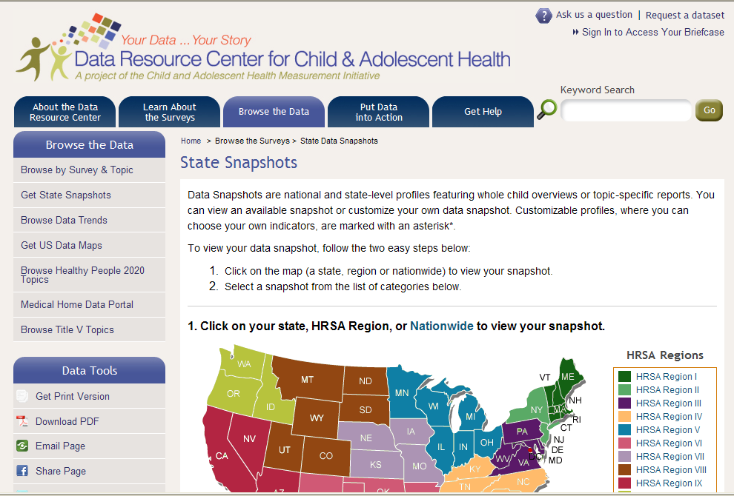
Data Resource Center www.childhealthdata.org

Slide 6
MCH Epi Training
MCH Epidemiology Training Course for States and local areas
Co-sponsor the MCH Epidemiology Conference with CDC
Annual series of 4 web-based MCH DataSpeaks providing skill building
Doctoral Epi Training Grant
Graduate Student Internship Program

Slide 7
Conduct and Disseminate Research to Expand MCH Evidence Base
Research Staff of 6
Special Journal Issues
Chartbooks
Children’s Health USA
Women’s Health USA
MCH Library - http://www.mchlibrary.info/
Technical Assistance
http://mchb.hrsa.gov/researchdata/mchirc/

Slide 8
Additional Training Resources
Public Health Training Centers
http://bhpr.hrsa.gov/grants/publichealth/trainingcenters
MCH Navigator - http://navigator.mchtraining.net/
MCH Epi Conference, listserve, grand rounds
http://www.cdc.gov/reproductivehealth/mchepi
AMCHP.org – annual data skill-building training
CityMatCH.org – PPOR training
MCHepi.org

Slide 9
Data Resources
HealthyPeople.gov, HealthIndicators.gov
CommunityHealth.HHS.gov
Title V Information System
https://perf-data.hrsa.gov/mchb/TVISReports/
MCH Data Connect http://dvn.iq.harvard.edu/dvn/dv/dataconnect
Peristats http://www.marchofdimes.com/peristats/
NSCH, NS-CSHCN, PRAMS, YRBSS, BRFSS, NIS, administrative records

Slide 10
Course Feedback
Content and format
Alternating skill level: beginner, more advanced
Breakout sessions: choose between a more advanced topic and open Q&A / consulting
Recording sessions for broader use
~3 post-training webinars
Technical assistance
Want to hear your success stories

Slide 11
Contact Information
Ashley Schempf, PhD
Aschempf@hrsa.gov
301.443.1496

